Slide 1

AWSCloud

Slide 2
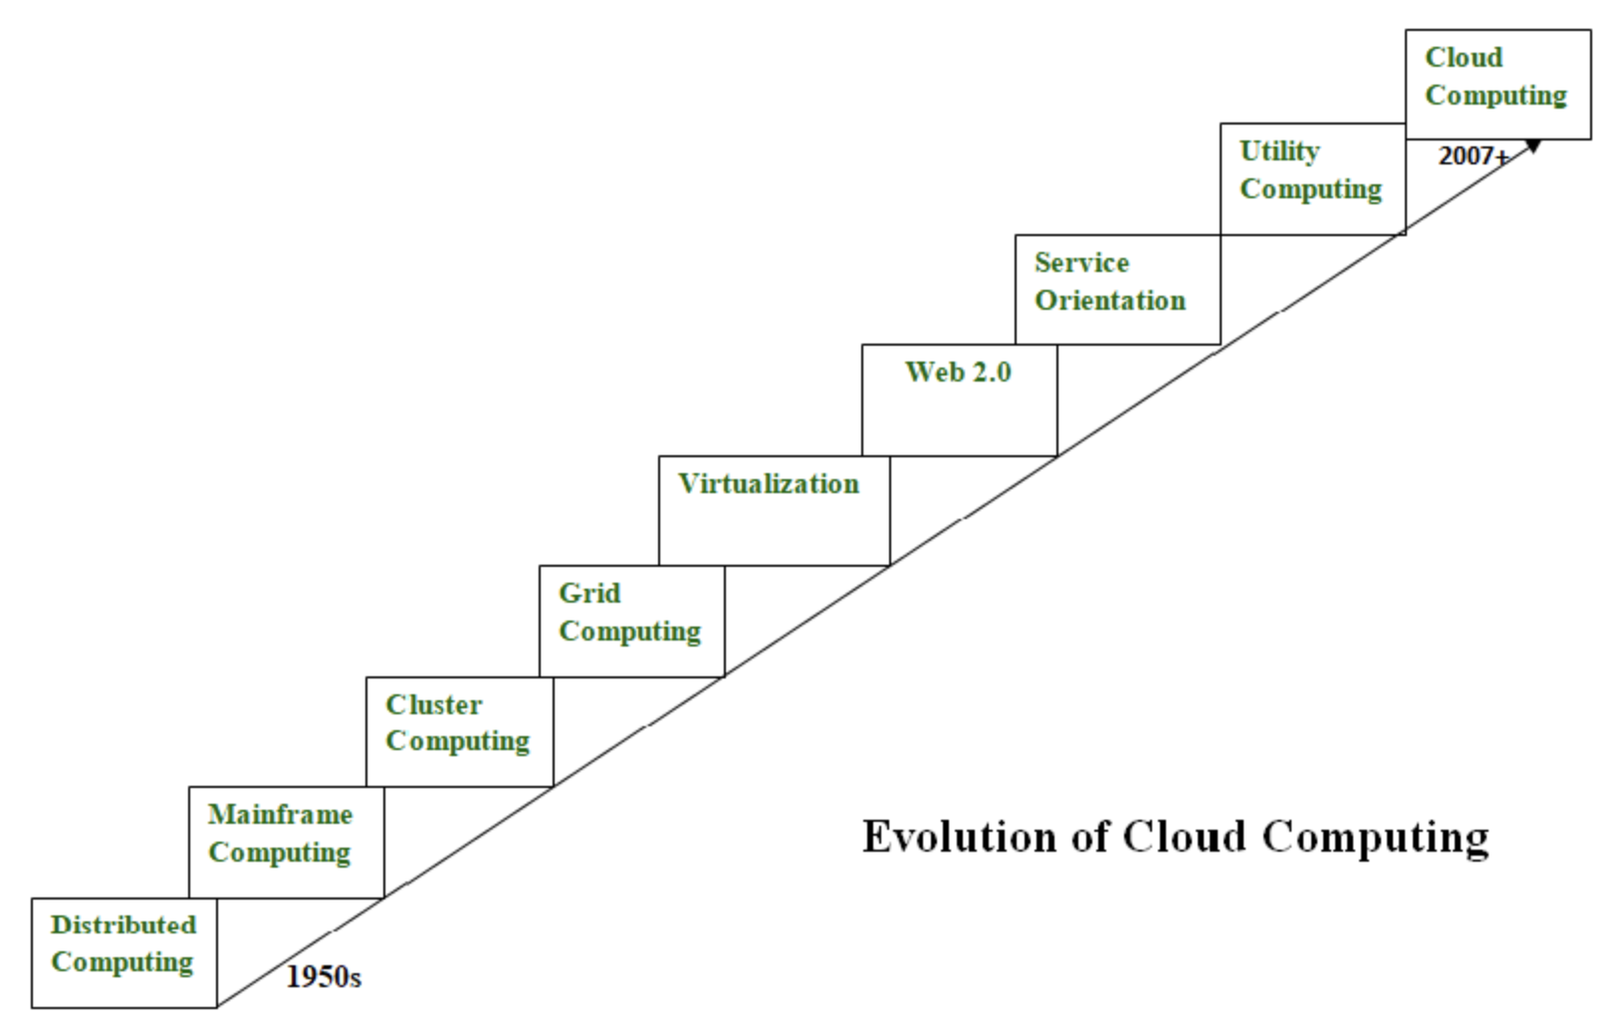
What is cloud computing?
Cloud computing is all about renting computing services. This idea first came in the 1950s. In making cloud computing what it is today, five technologies played a vital role. These are distributed systems and its peripherals, virtualization, web 2.0, service orientation, and utility computing.

Slide 3
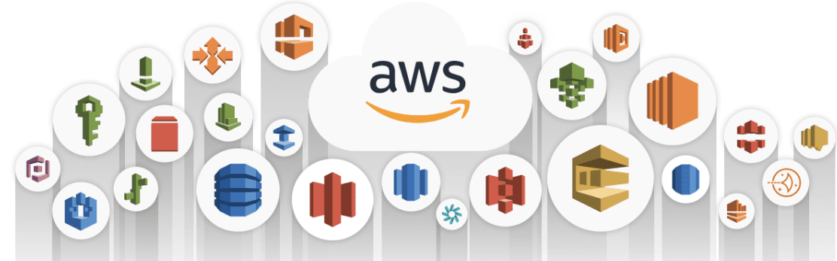
What is cloud computing?
Cloud computing is the on-demand delivery of compute power, database, storage, applications, and other IT resources through a cloud services platform through the internet with pay-as-you-go pricing. Traditionally, a developer looking to build an application had to procure, set up, and maintain physical infrastructure and the application. This is where cloud computing comes in.
A cloud services platform provides rapid access to flexible and low-cost IT resources that you can use to build and maintain software and databases, and create applications to delight customers. You don’t need to make large upfront investments in hardware and spend a lot of time on the heavy lifting of managing that hardware. You can access as many resources as you need, almost instantly, and only pay for what you use. On-demand, pay-as-you-go access to services is fundamental to the cloud computing model.

Slide 4
Advantages of cloud computing
The cloud provides developers with greater flexibility, scalability, and faster time to innovation. With cloud computing, you can Pay as you go - Pay only when you use computing resources, and only for how much you use.
Benefit from massive economies of scale - AWS aggregates usage from hundreds of thousands of customers in the cloud, which leads to higher economies of scale. This translates into lower pay-as-you-go prices.
Stop guessing capacity - When you make a capacity decision prior to deploying an application, you often end up either sitting on expensive idle resources or dealing with limited capacity. With cloud computing, you can access as much or as little capacity as you need, and scale up and down as required with only a few minutes notice.
Increase speed and agility - IT resources are only a click away, which means that you reduce the time to make resources available to your developers from weeks to minutes. This dramatically increases agility for the organization, because the cost and time it takes to experiment and develop is significantly lower.
Realize cost savings - Companies can focus on projects that differentiate their business instead of maintaining data centers. With cloud computing, you can focus on your customers, rather than on the heavy lifting of racking, stacking, and powering physical infrastructure.
Go global in minutes - Applications can be deployed in multiple Regions around the world with a few clicks. This means that you can provide lower latency and a better experience for your customers at a minimal cost.

Slide 5
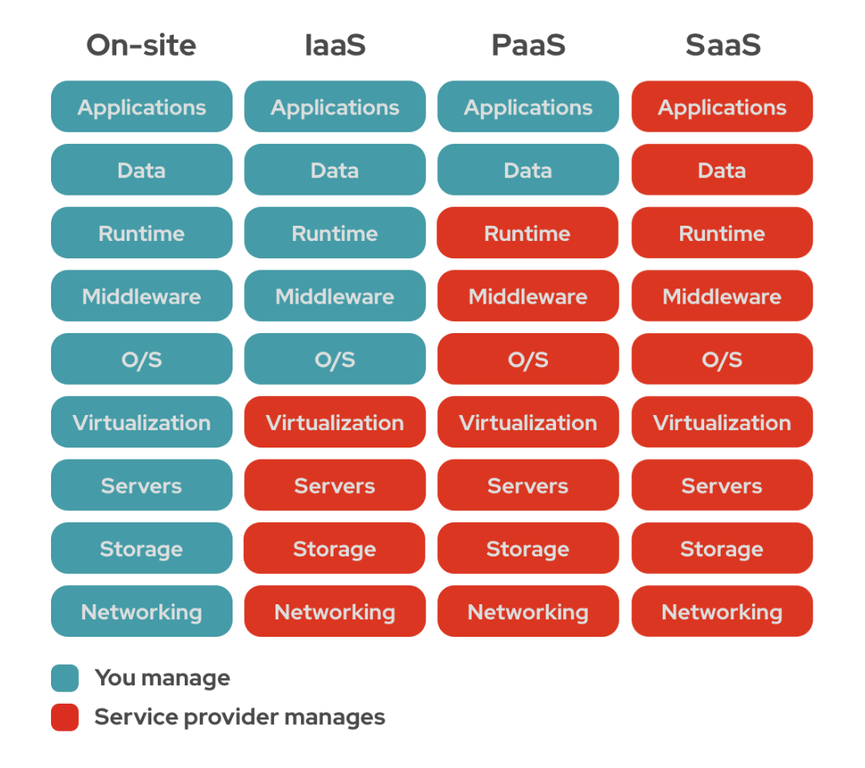
SaaS, IaaS & PaaS
These are 3 main types of cloud computing as-a-service options and each one covers a degree of management for you: infrastructure-as-a-service (IaaS), platform-as-a-service (PaaS), and software-as-a-service (SaaS).

Slide 6
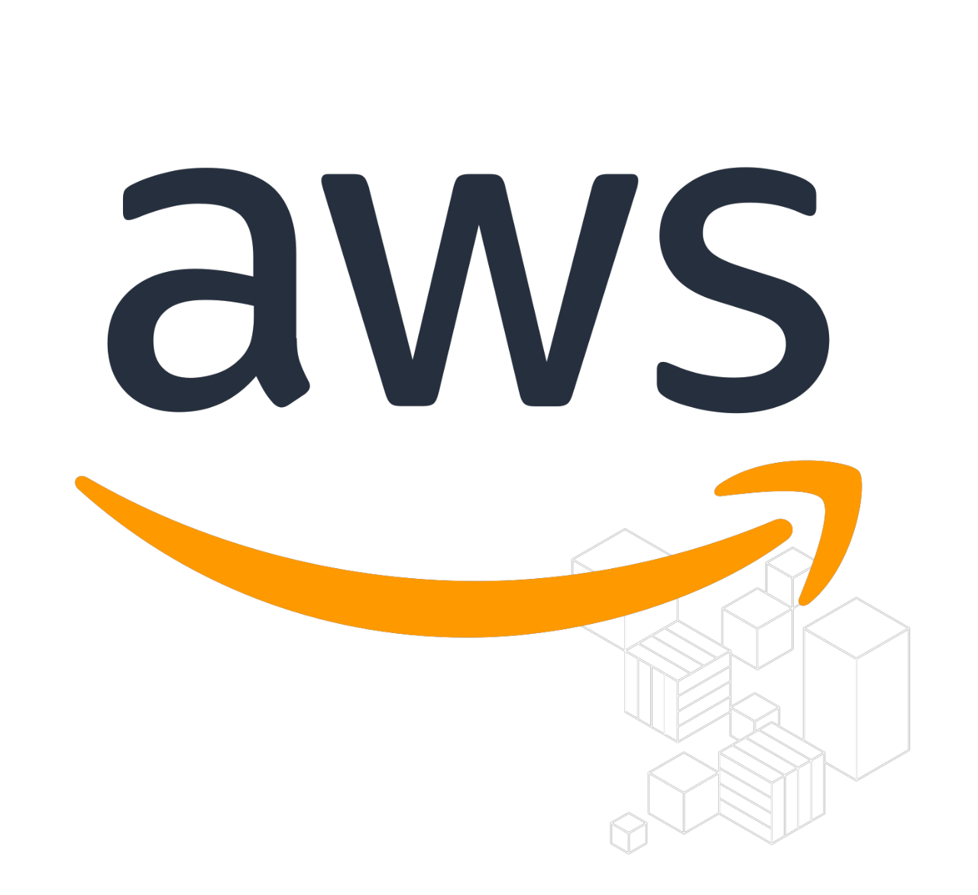
What is AWS?
Cloud Platform
Publicly Available from 2006
Global Presence • 200 + Services • Utility Pricing
Free Tier to get started

Slide 7
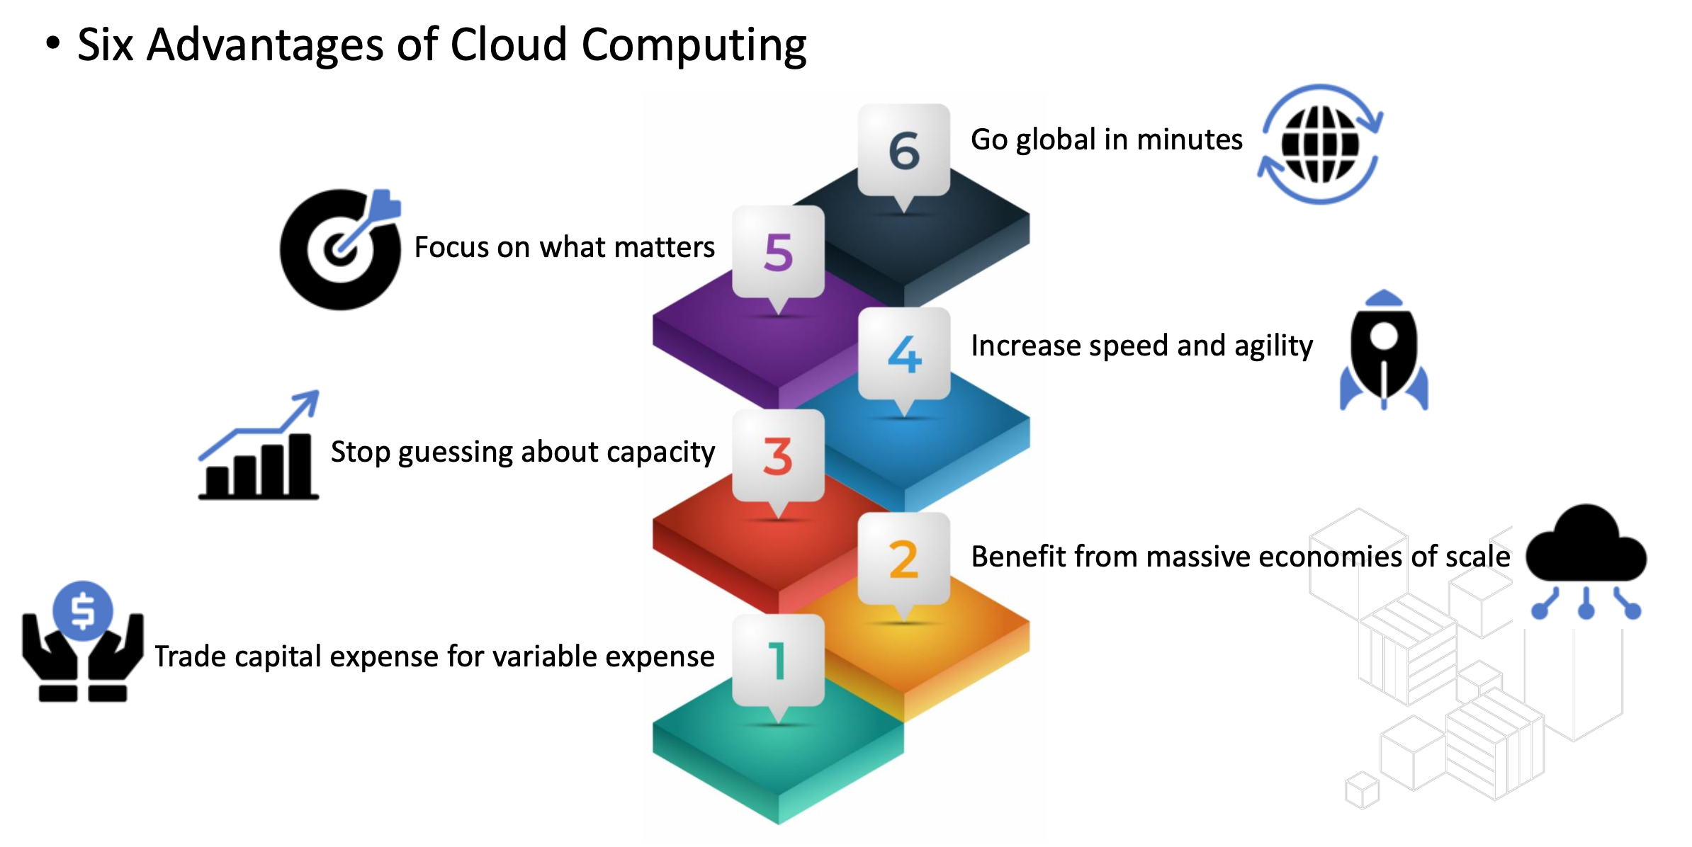
Why companies are using Cloud Computing?

Slide 8
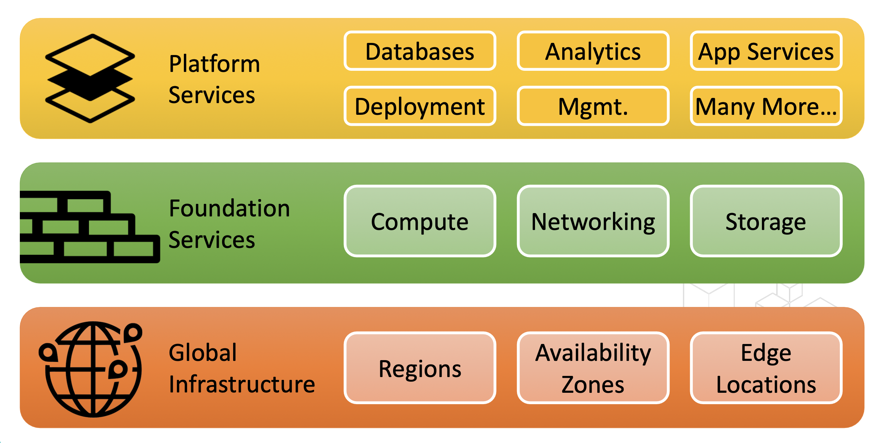
AWS Services Stack

Slide 9
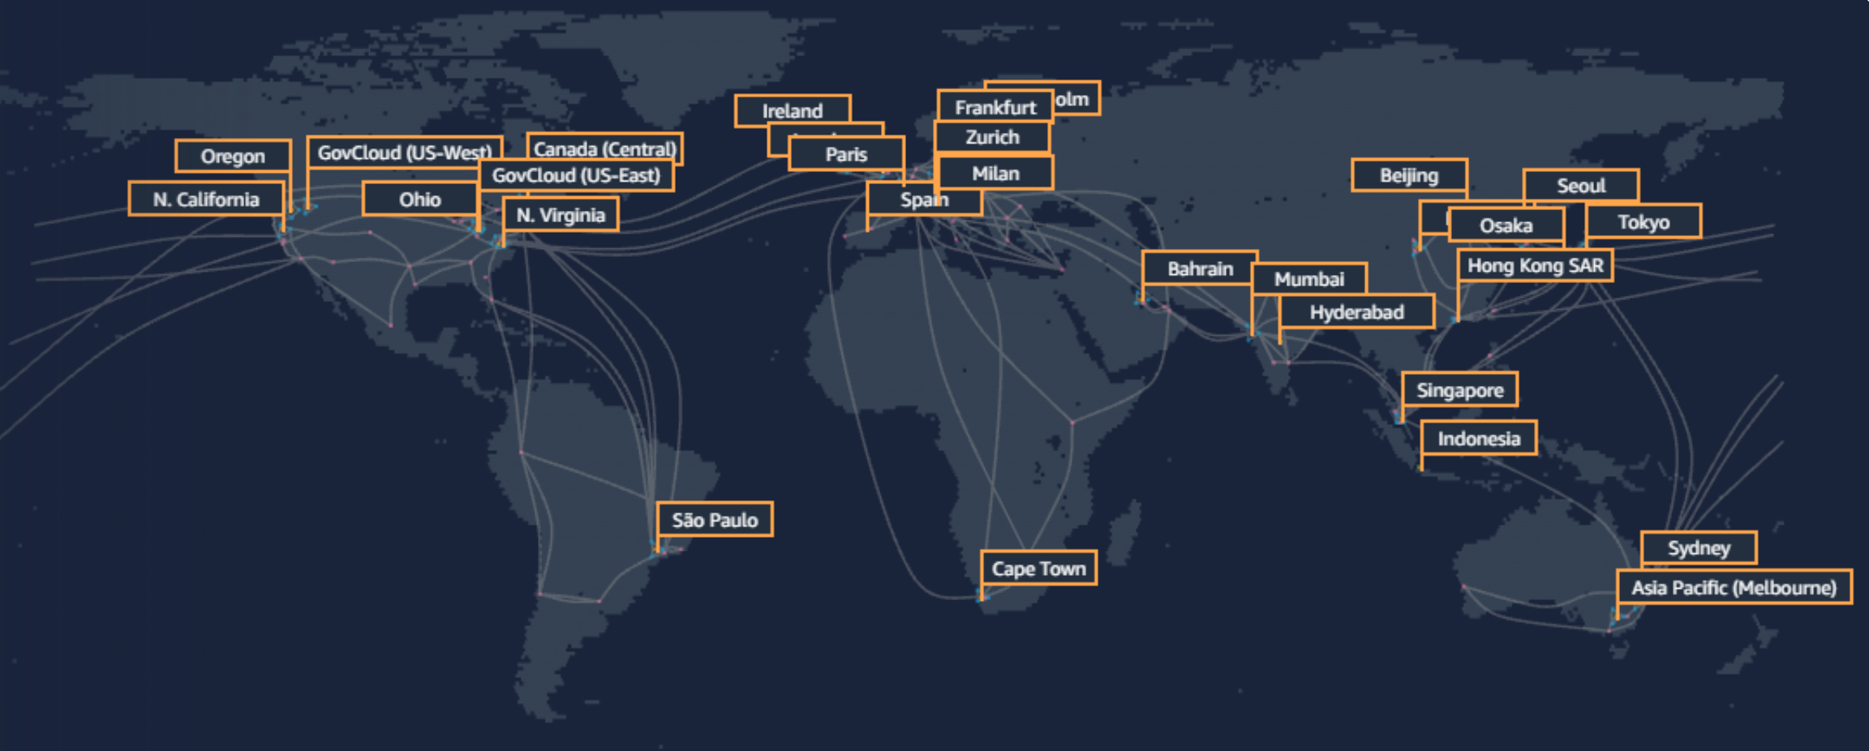
AWS Global Infrastructure

Slide 10
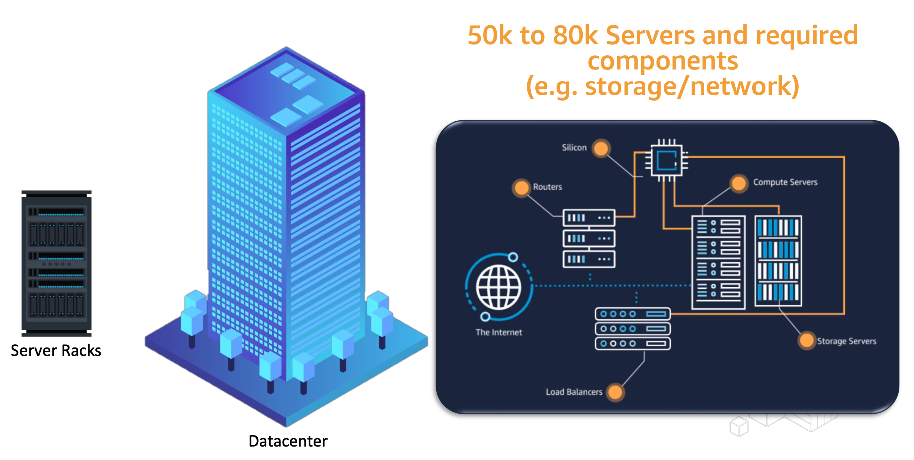
AWS DataCenter

Slide 11
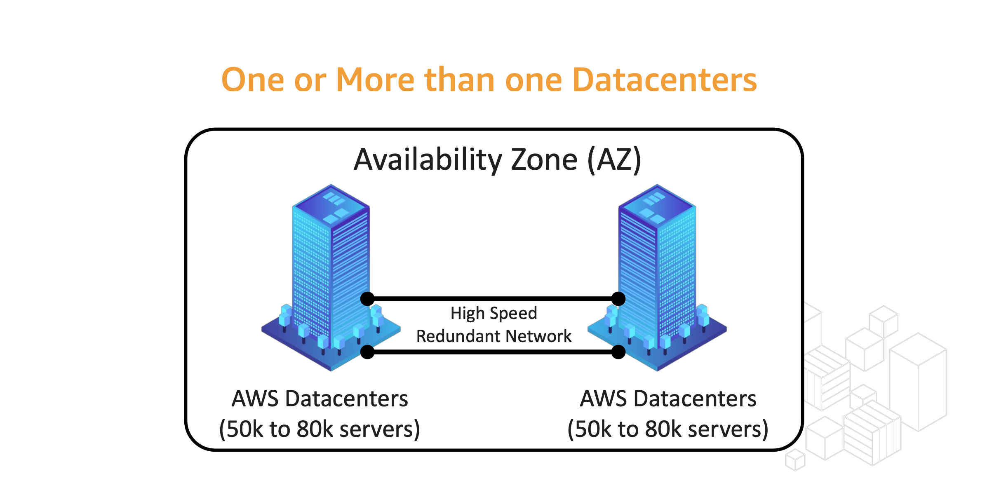
Availability Zone (AZ) – Group of Datacentres
An Availability Zone (AZ) is one or more discrete data centres with redundant power, networking, and connectivity in an AWS Region. AZs give customers the ability to operate production applications and databases that are more highly available, fault tolerant, and scalable than would be possible from a single data centre.

Slide 12
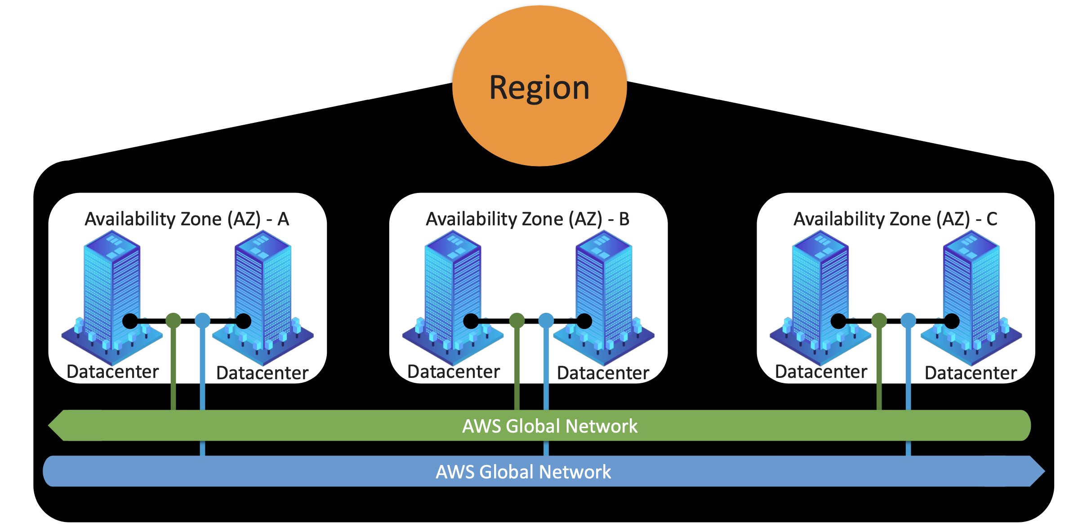
Region – Group of AZs
AWS has the concept of a Region, which is a physical location around the world where we cluster data centres. We call each group of logical data centres an Availability Zone. Each AWS Region consists of a minimum of three, isolated, and physically separate AZs within a geographic area.

Slide 13
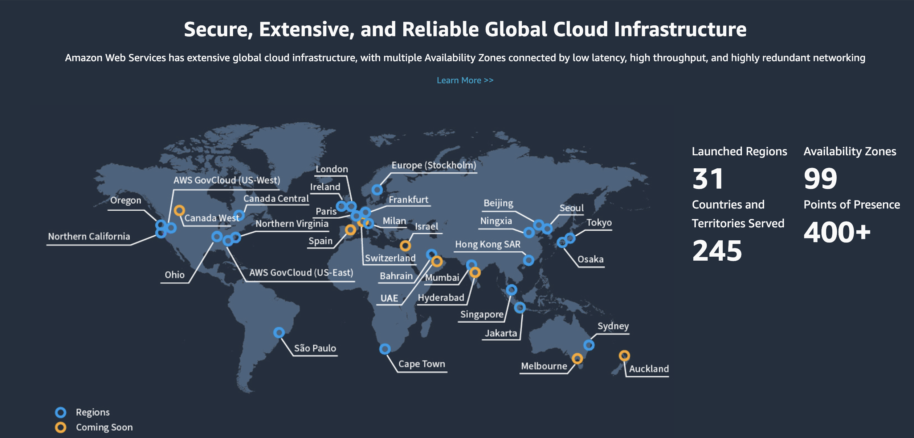
AWS Global Infrastructure
AWS has the largest global infrastructure footprint of any cloud provider. Every data center, AZ, and AWS Region is interconnected via a purpose-built, highly available, and low-latency private global network infrastructure. The network is built on a global, fully redundant, parallel 100 GbE metro fiber network that is linked via trans-oceanic cables across the Atlantic, Pacific, and Indian Oceans, as well as the Mediterranean, Red Sea, and South China Seas.

Slide 14
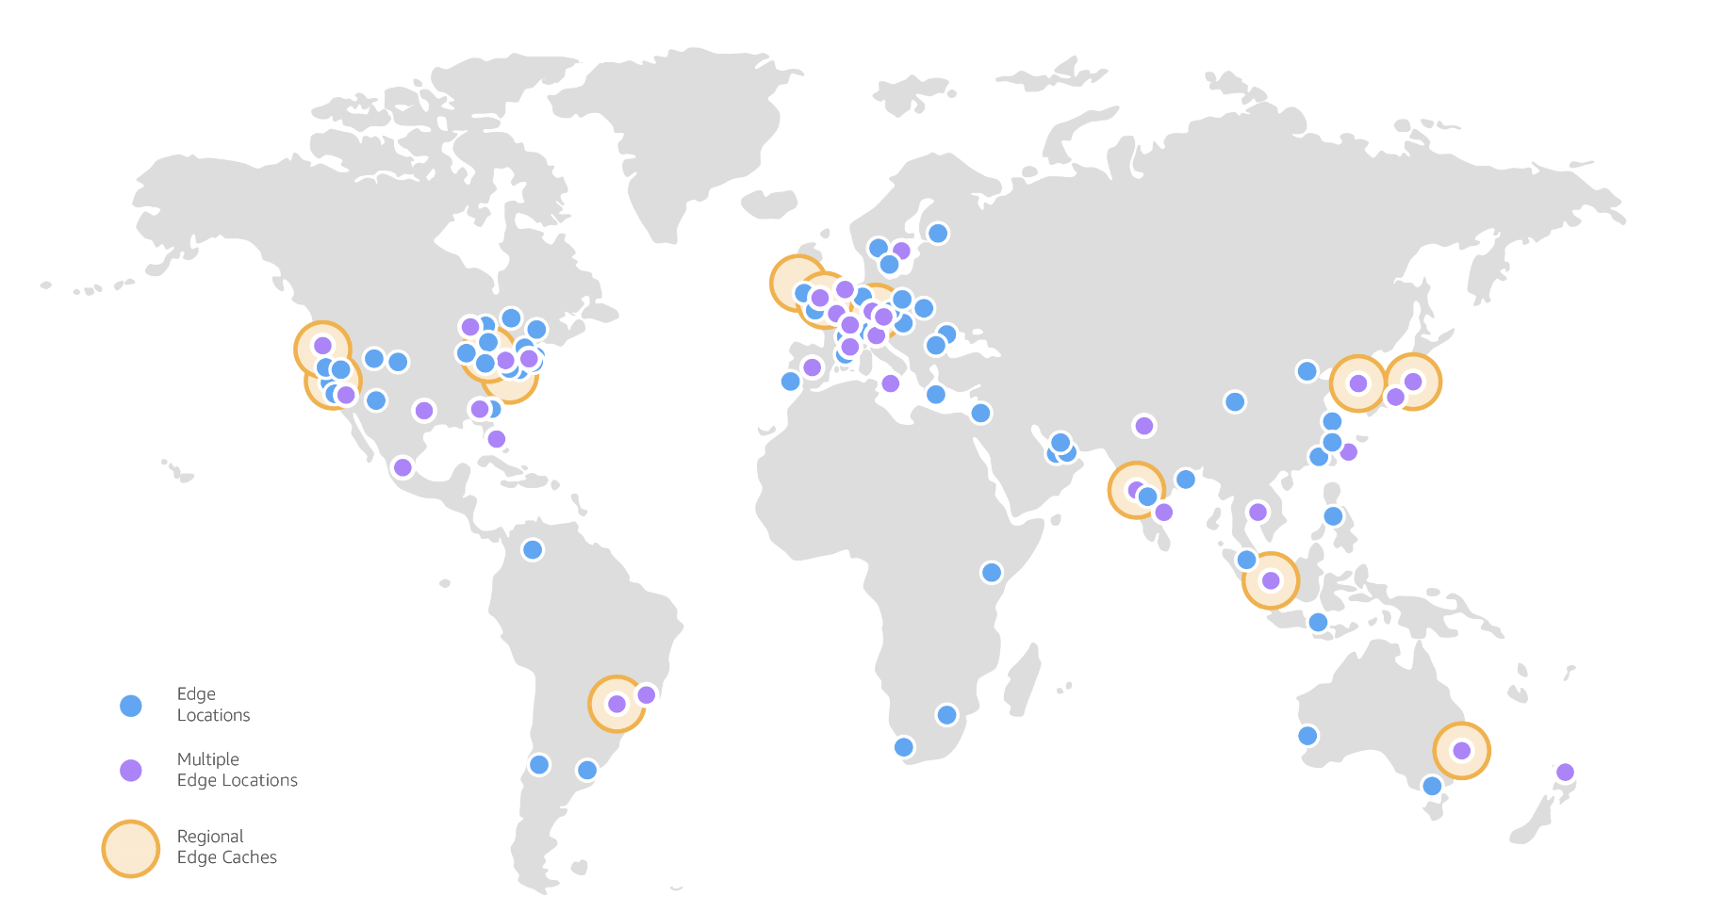
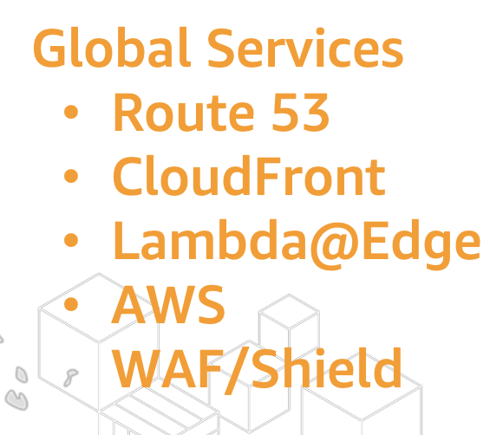
AWS Edge Locations / Point of Presence (PoP)
A site that CloudFront uses to cache copies of your content for faster delivery to users at any location.

Slide 15
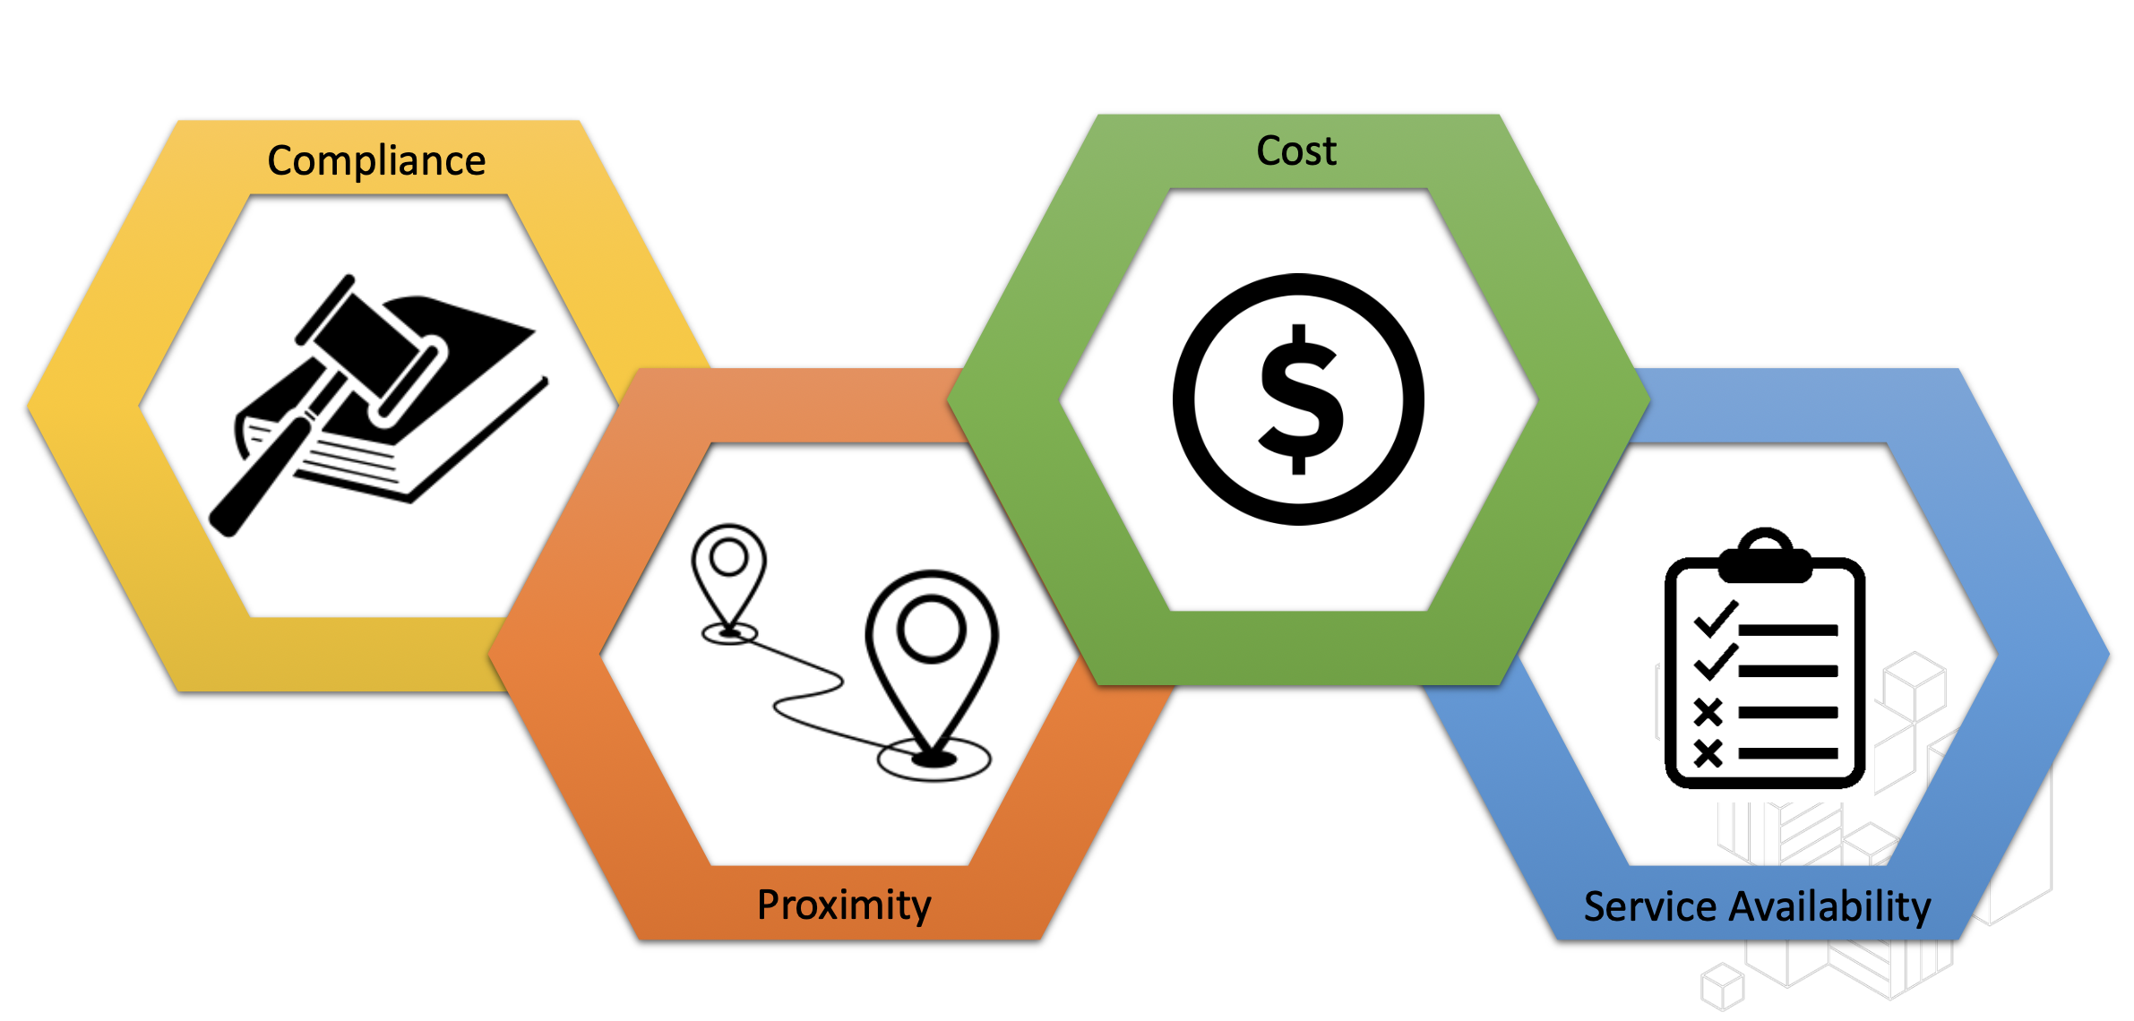
AWS Region Selection

Slide 16
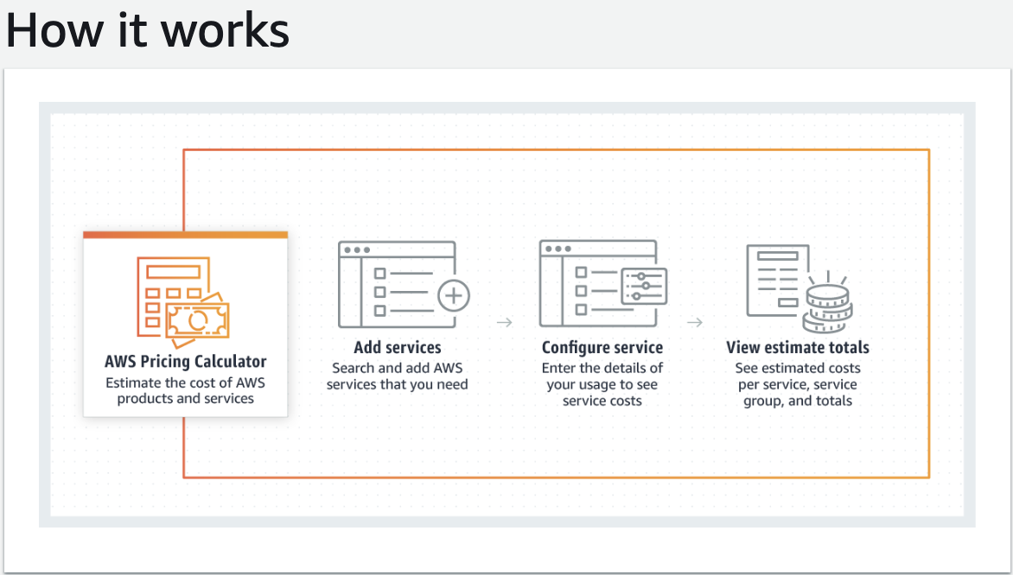
AWS Pricing Calculator
Estimate the cost for your architecture solution. Configure a cost estimate that fits your unique business or personal needs with AWS products and services.

Slide 17
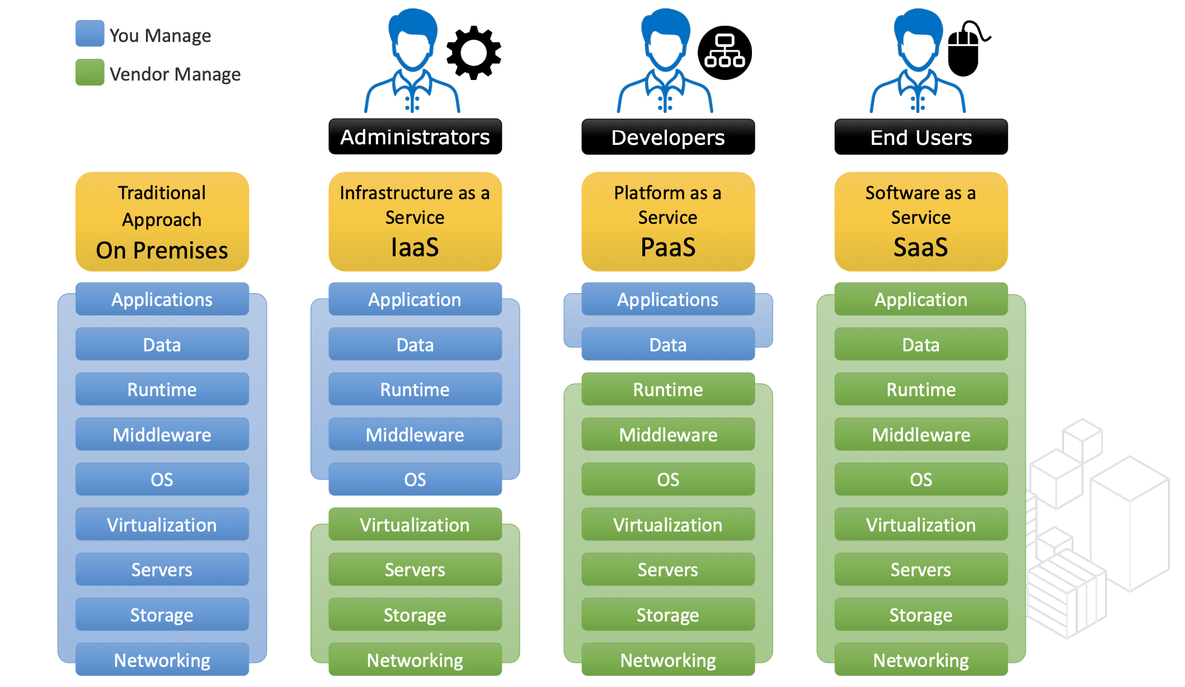
Service Models - Cloud Offering – IaaS vs PaaS vs SaaS

Slide 18
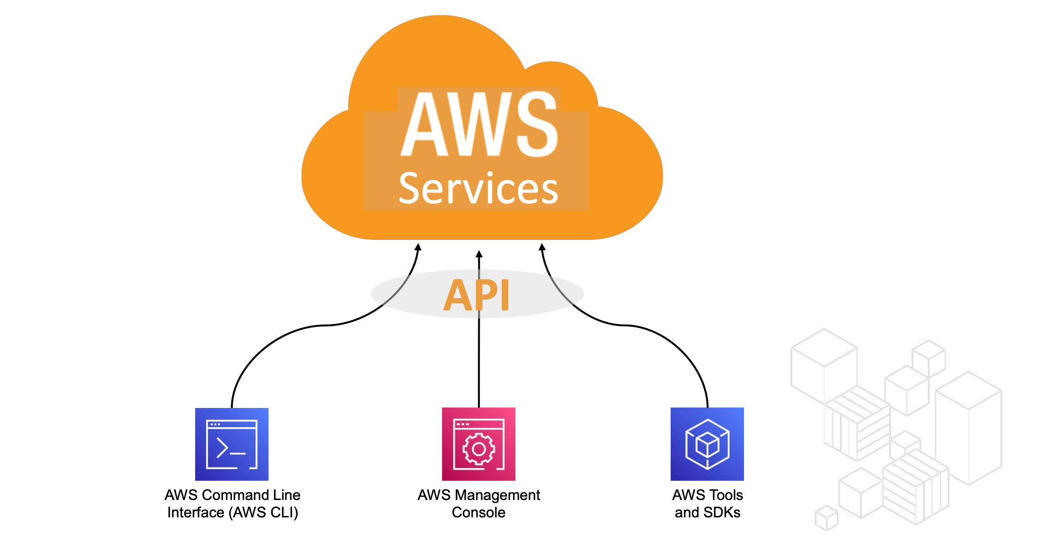
Accessing AWS Services

Slide 19
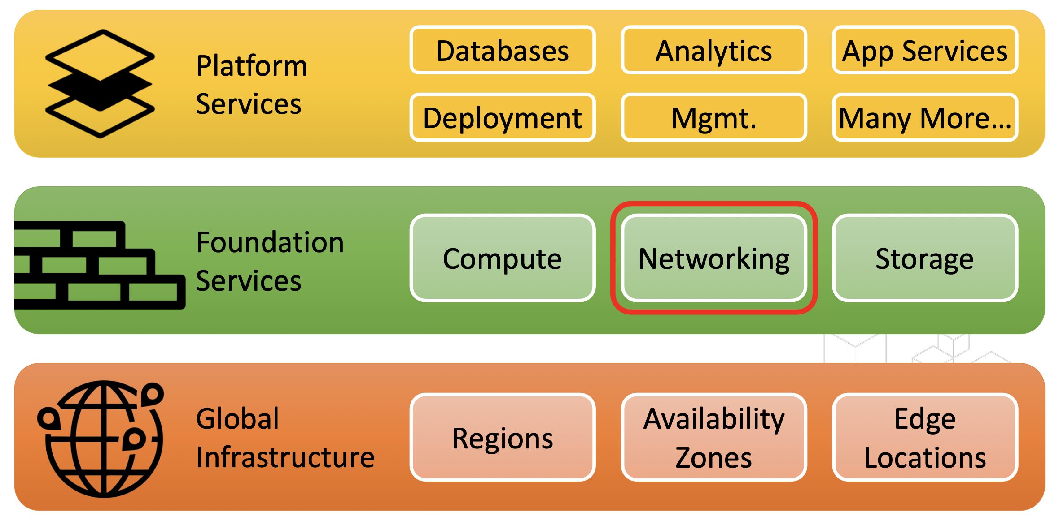
AWS Service Stack

Slide 20
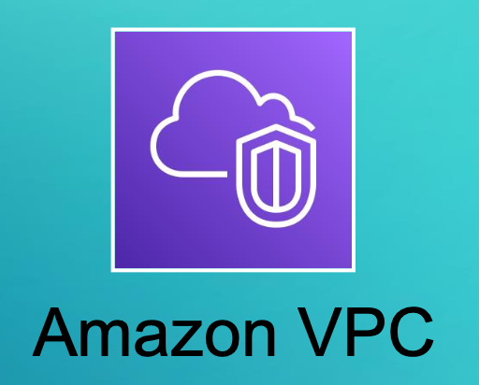
Networking in AWS

Slide 21
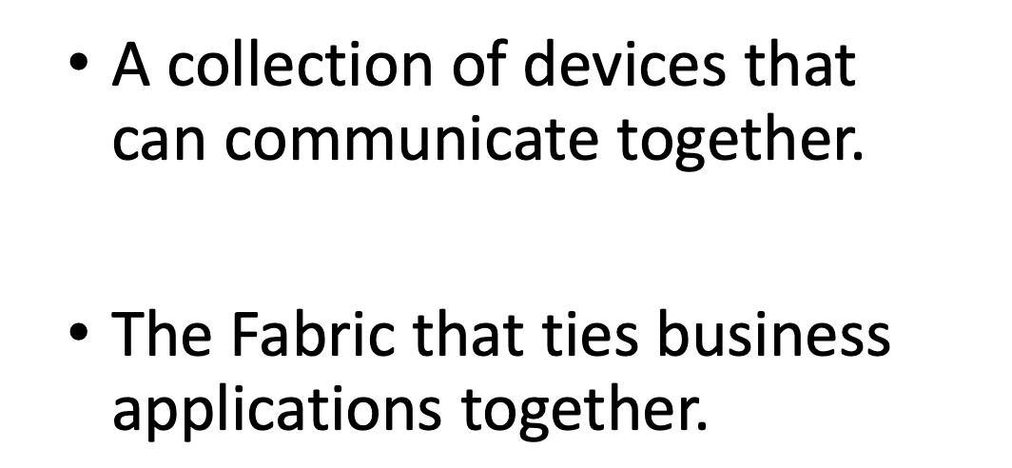
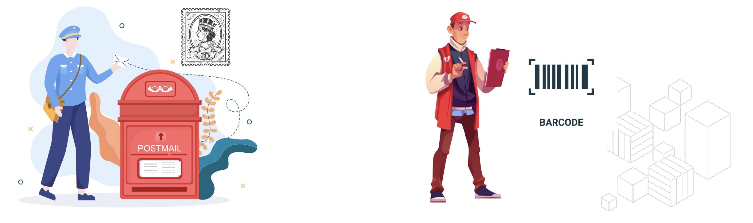
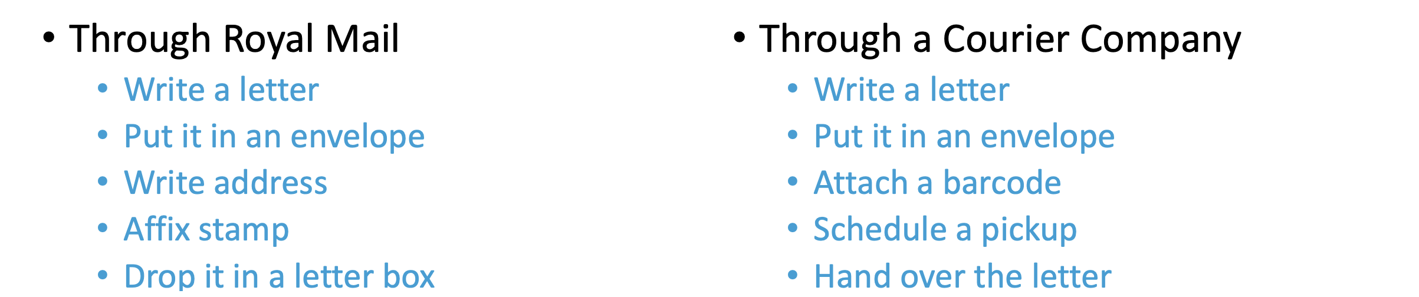
Networking
What is a protocol?
Standards of Communication
• In this example: • Packaging
• Addressing • Payment • Getting the package on the network
• Computers on a network must agree upon a common protocol in order to communicate

Slide 22
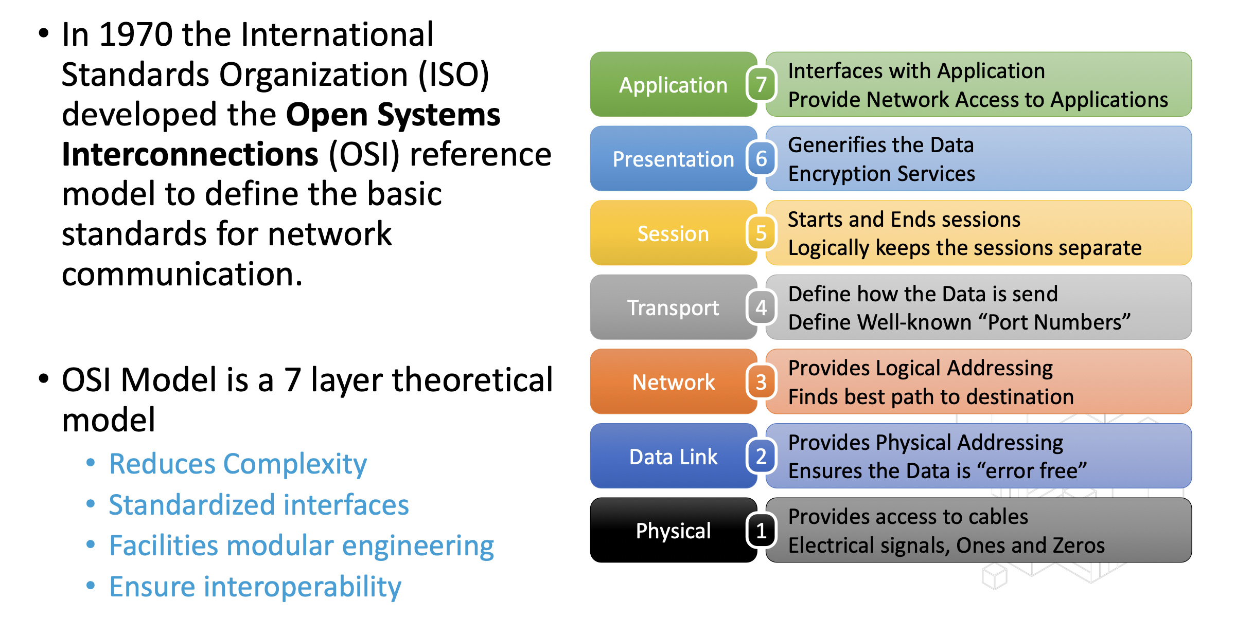
Open System Interconnection Model (OSI Model)

Slide 23
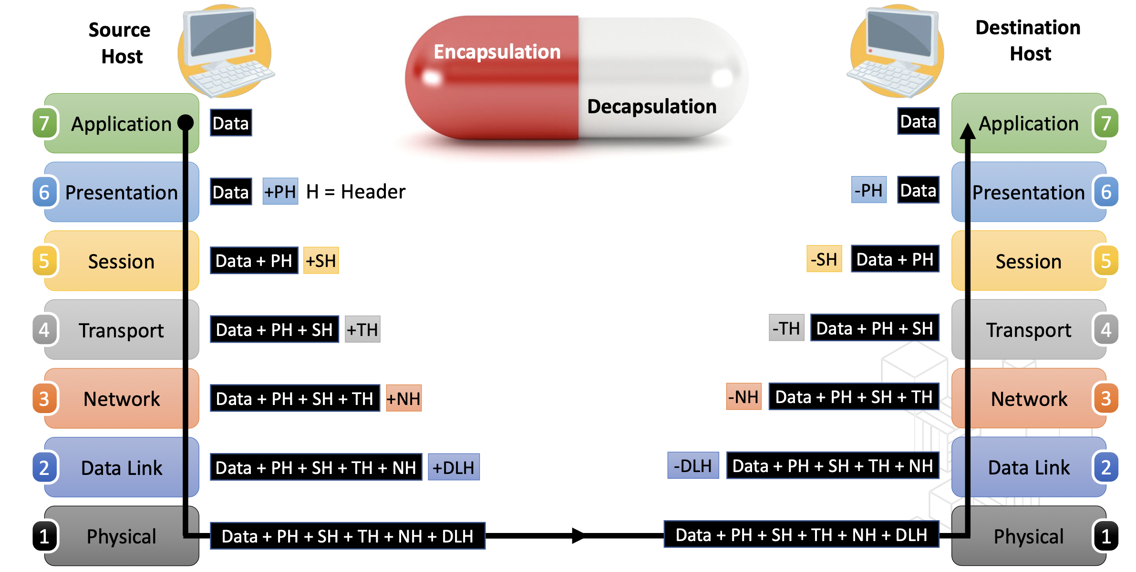
Open System Interconnection Model (OSI Model)

Slide 24
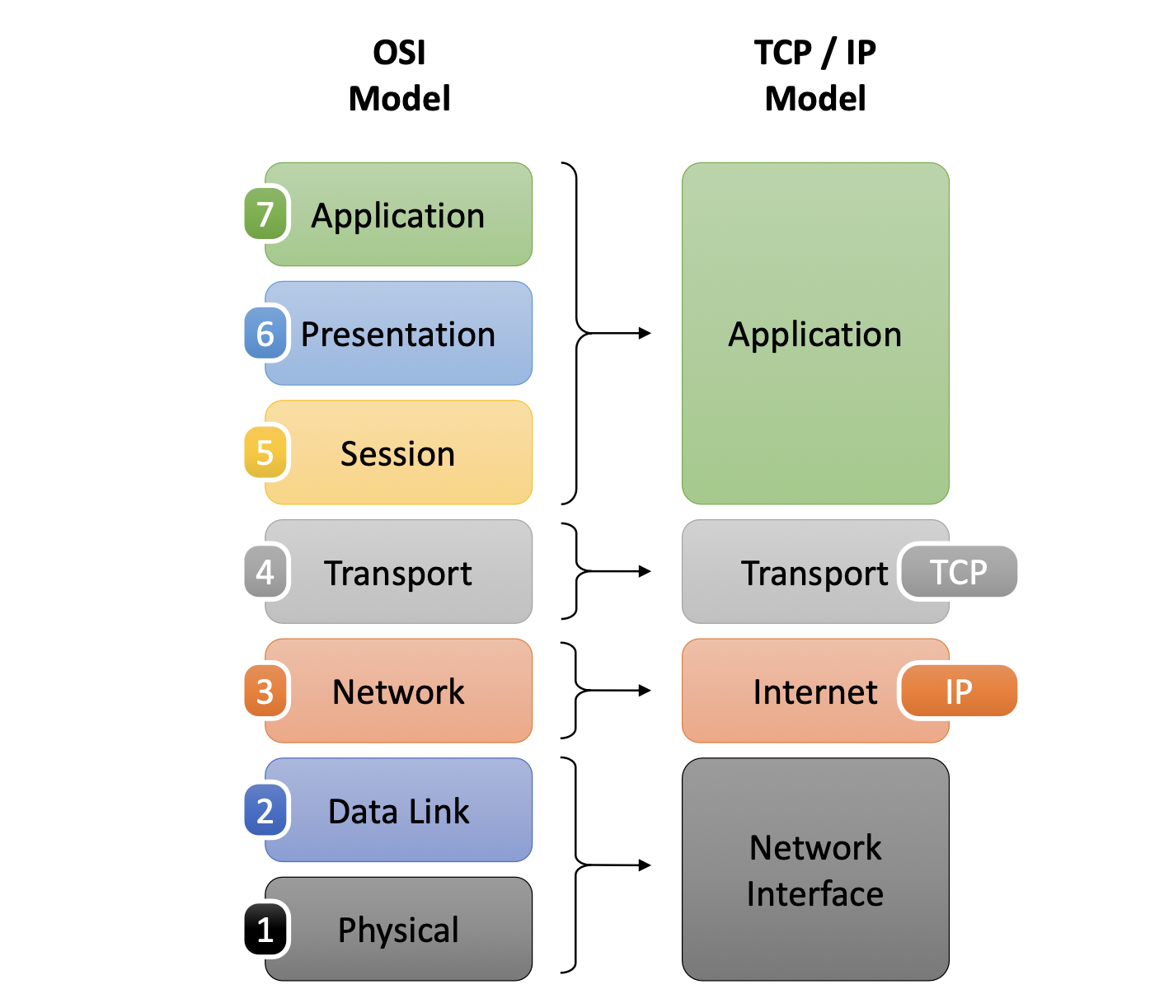
OSI vs TCP/IP Model

Slide 25
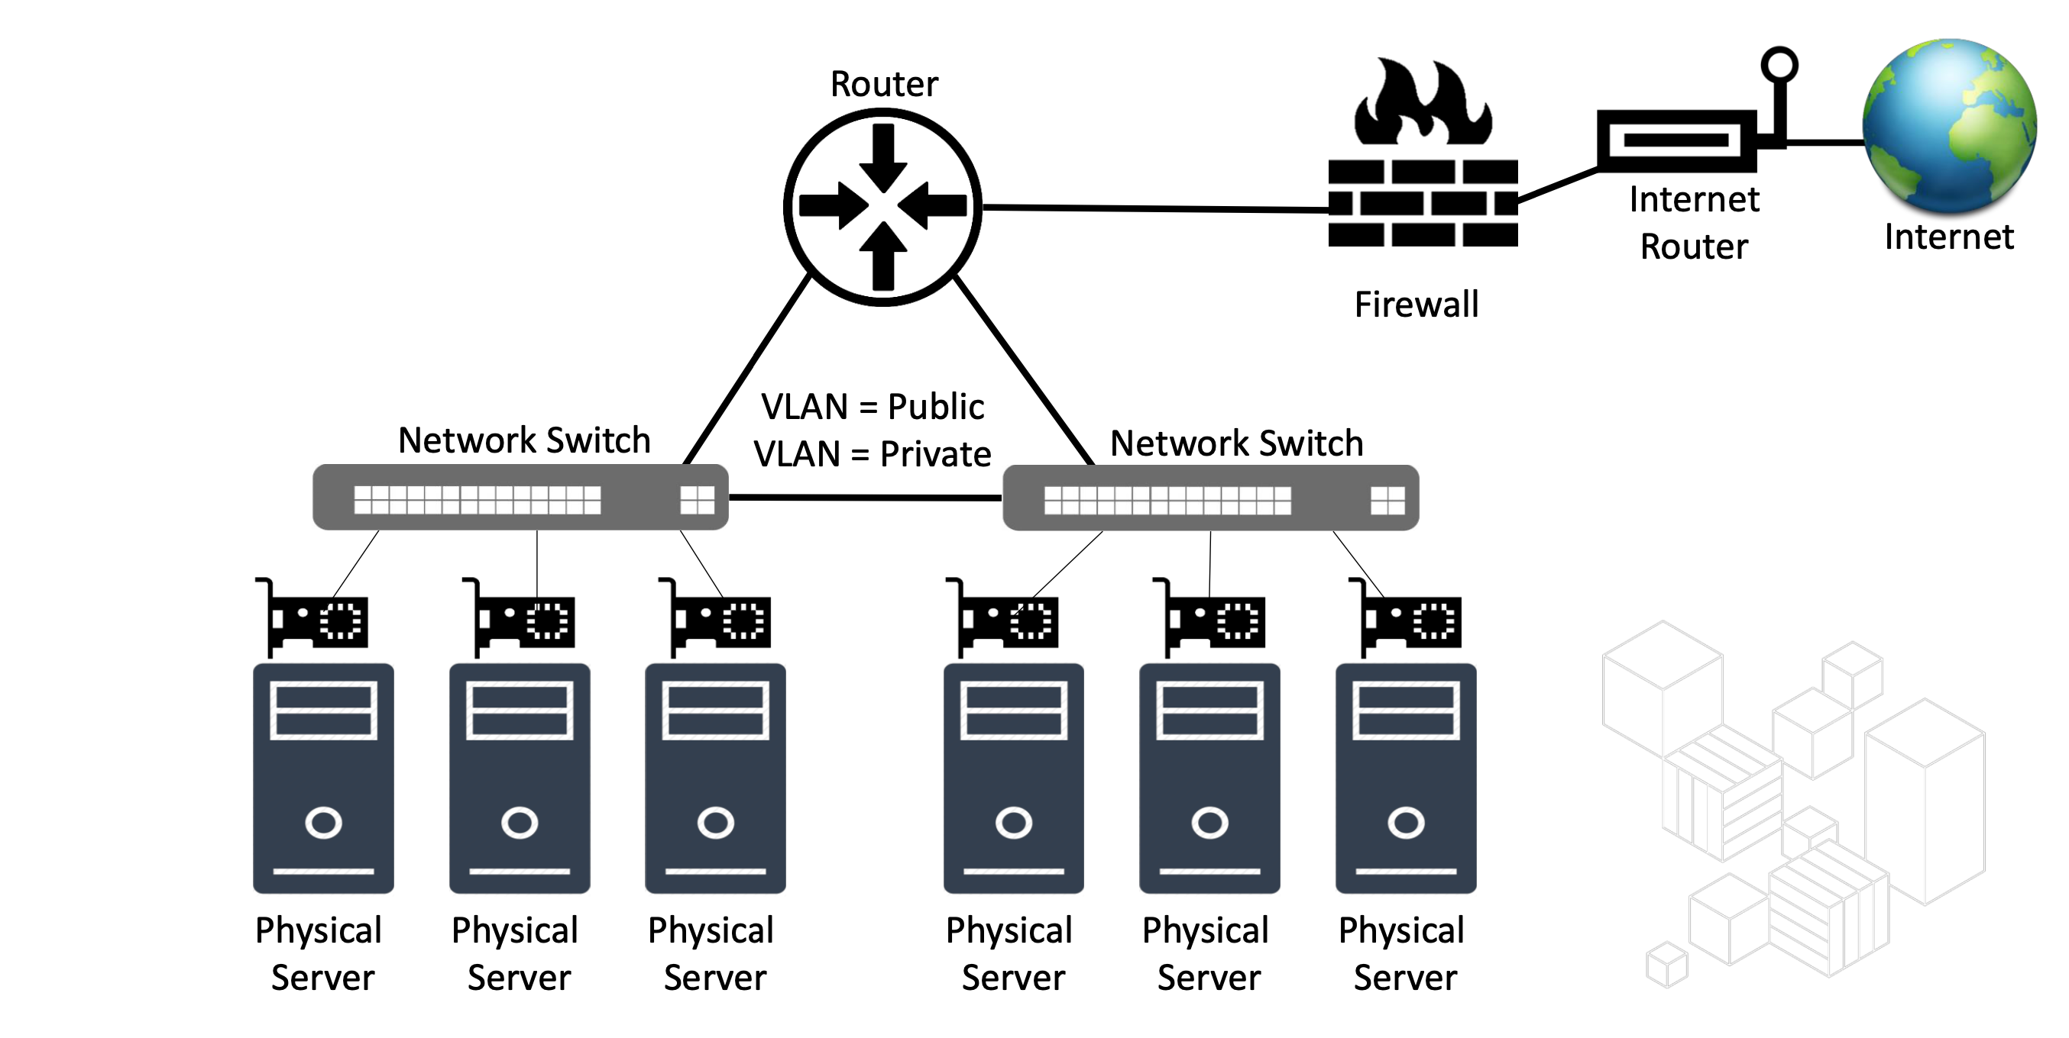
Networking in Physical World
Security groups, network ACLs
Routing tables
IGW
N1
N2
subnet
ENI
ec2

Slide 26
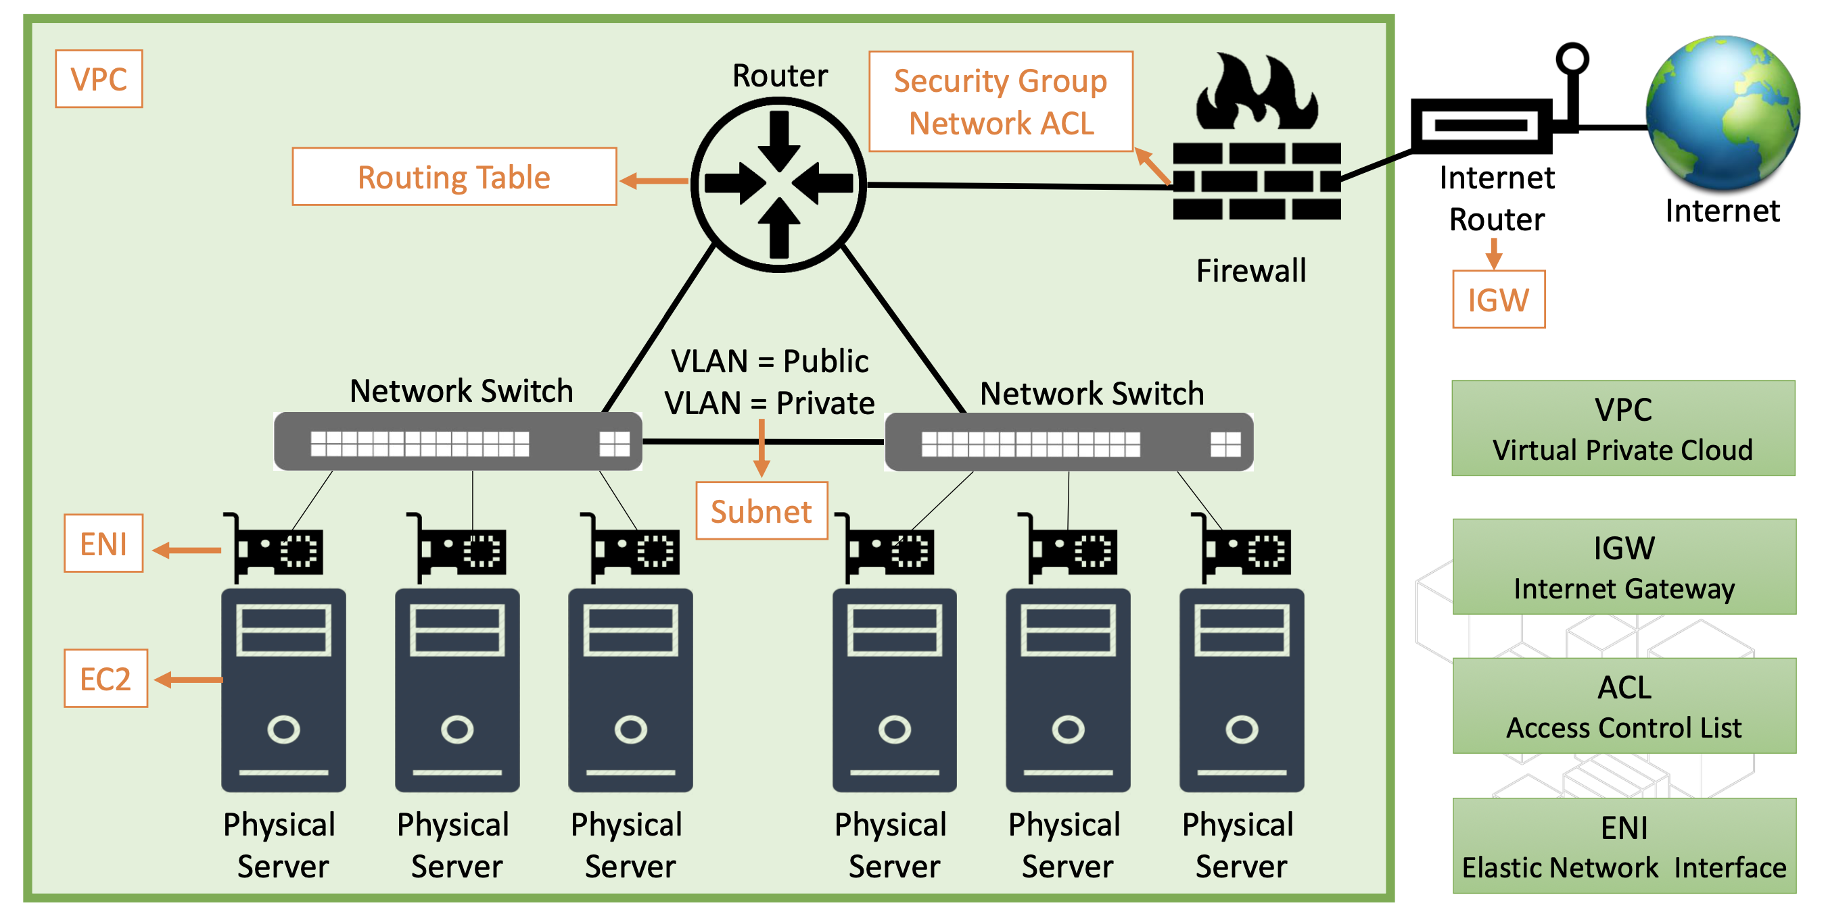
Networking in AWS

Slide 27
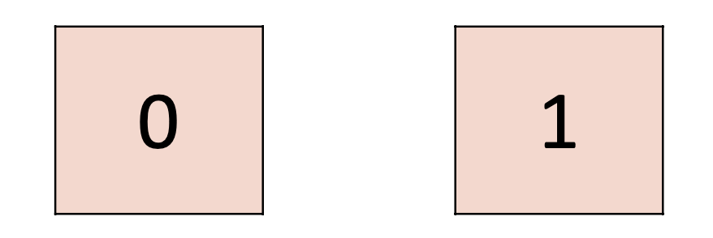
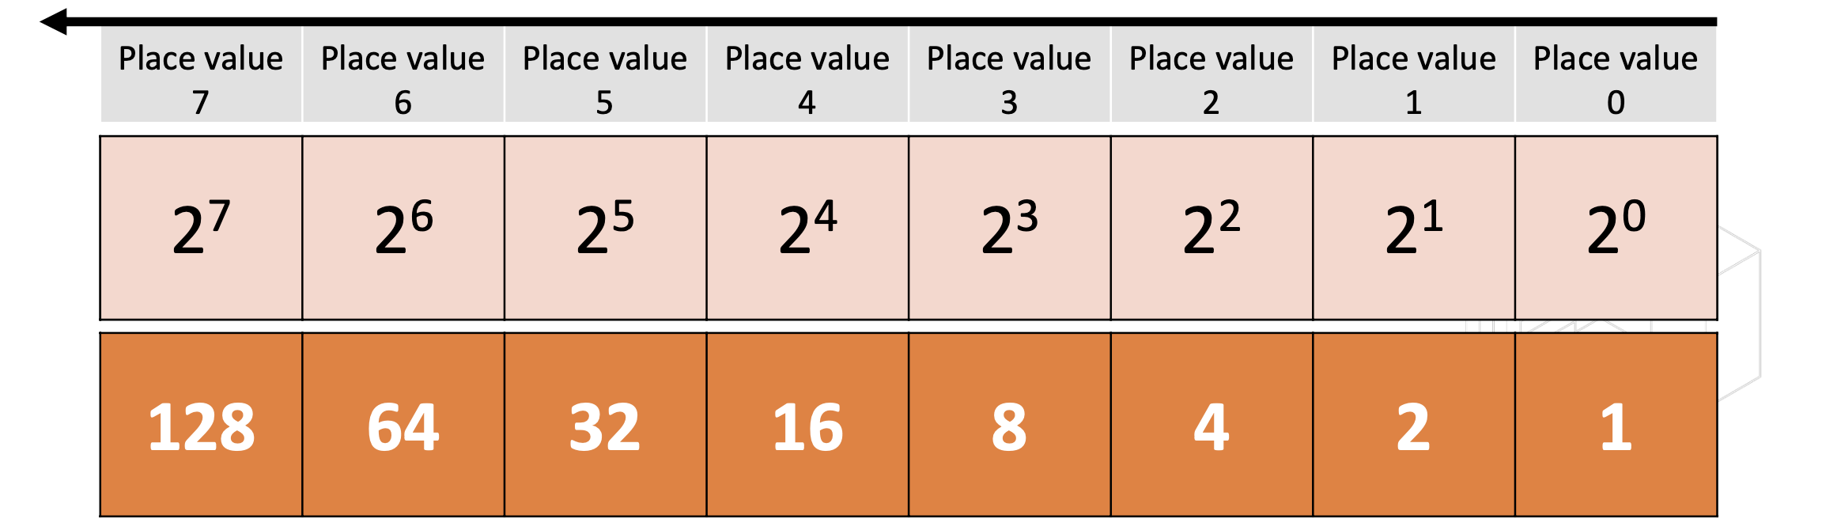
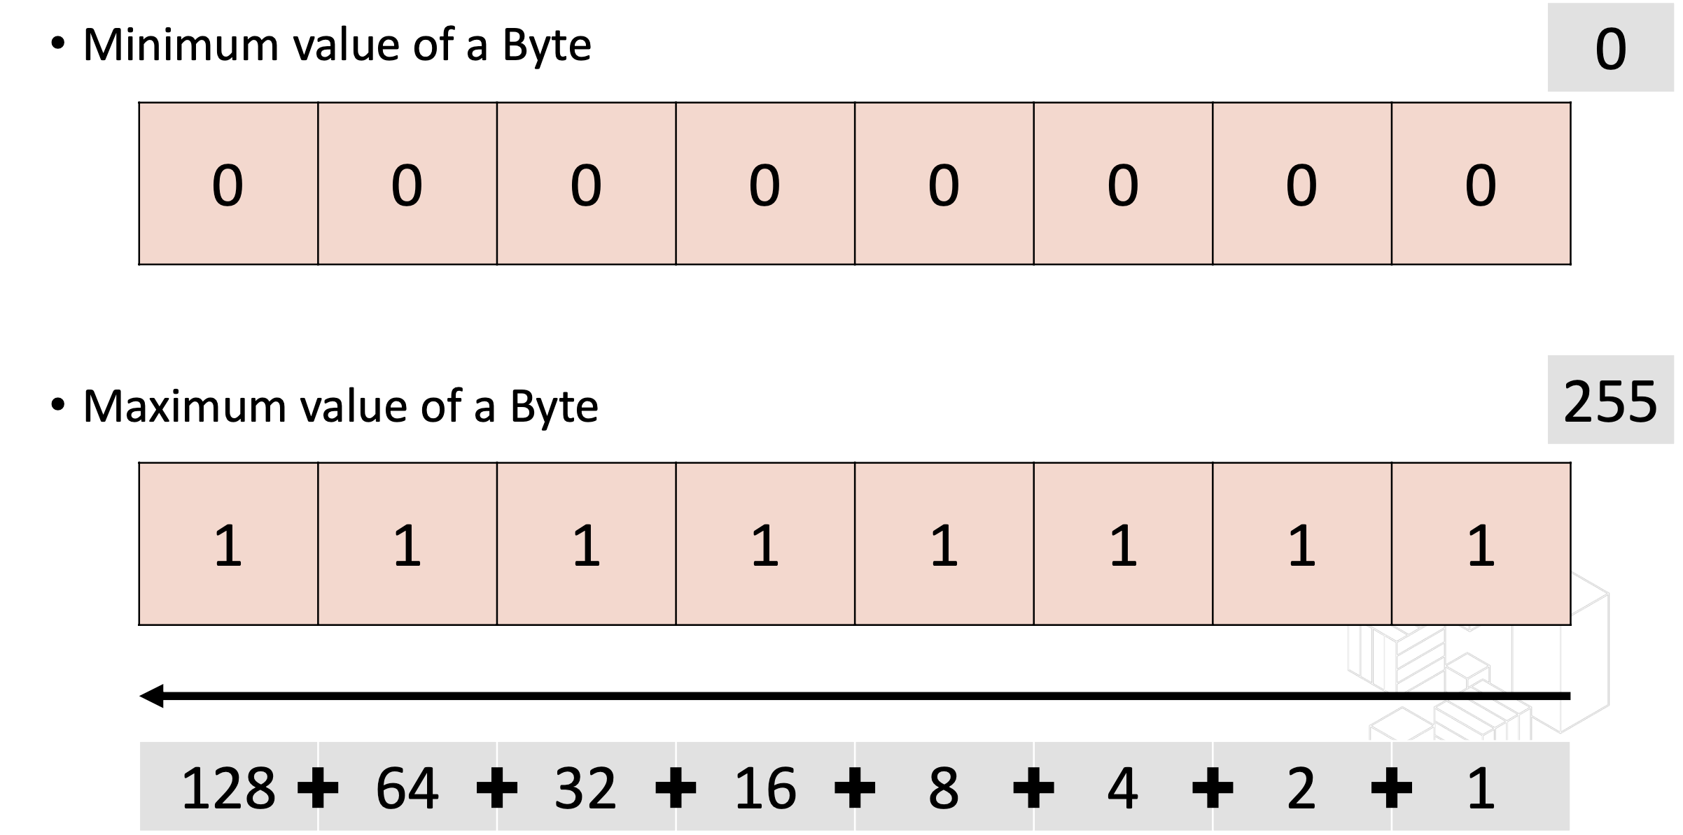
Binary Choice, Bits and Bytes
We humans use decimal number system. (0, 1, 2, 3, 4, 5, 6, 7, 8, 9)
Computers use binary number system (1 and 0).
A bit can have a single value out of 2 possible values – Either 0 or 1
8 bits combined is a byte

Slide 28
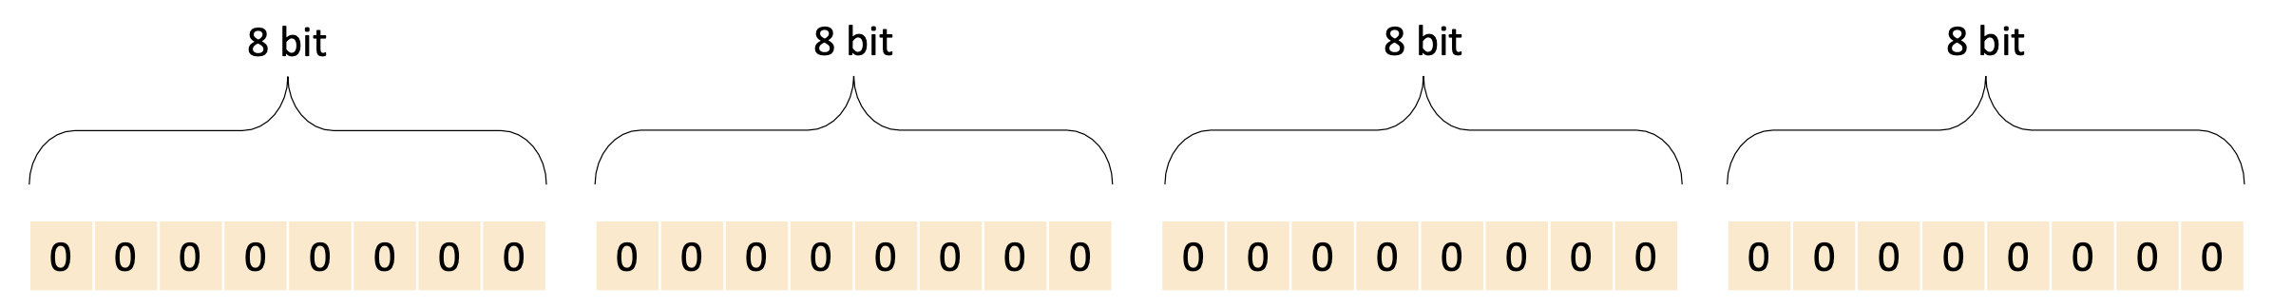
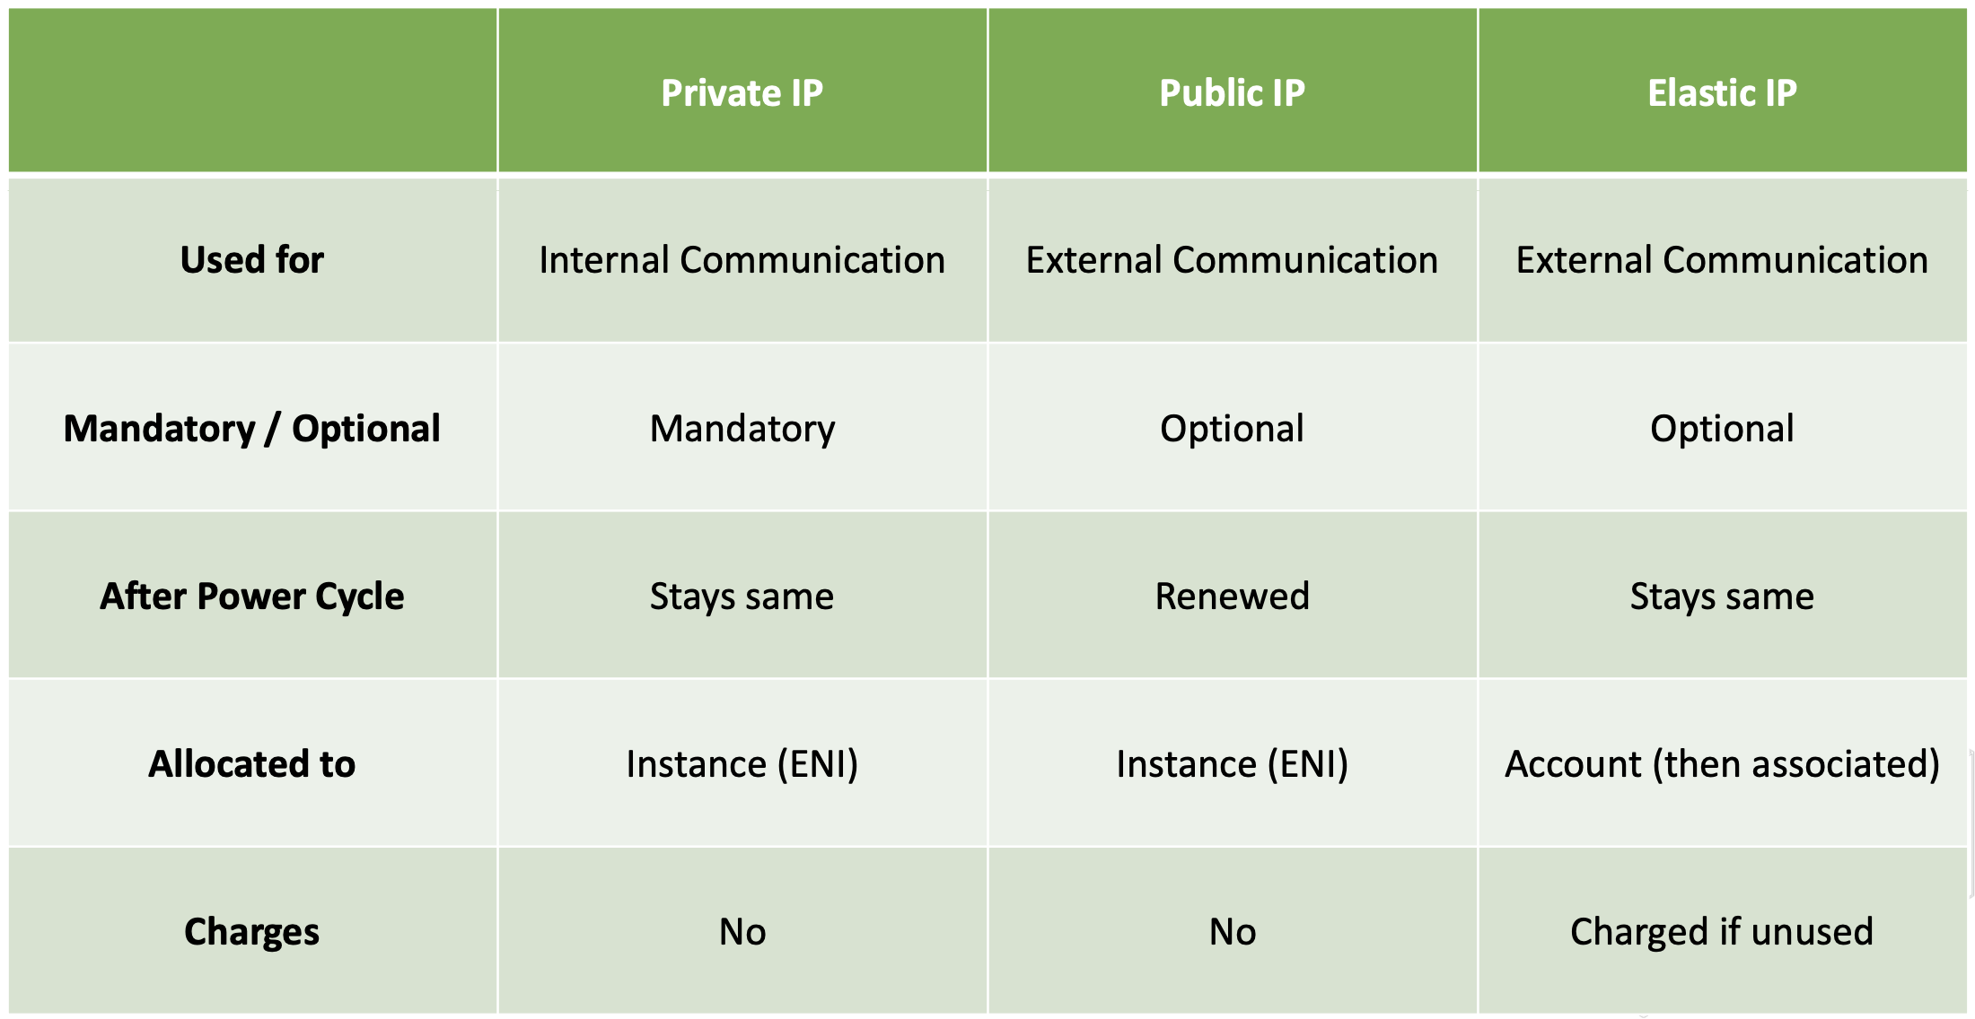
IPv4 addresses
A device on the TCP/IP network is identified by its IP address , IPv4 addresses are 32 bit, From 0.0.0.0 up to 255.255.255.255

Slide 29
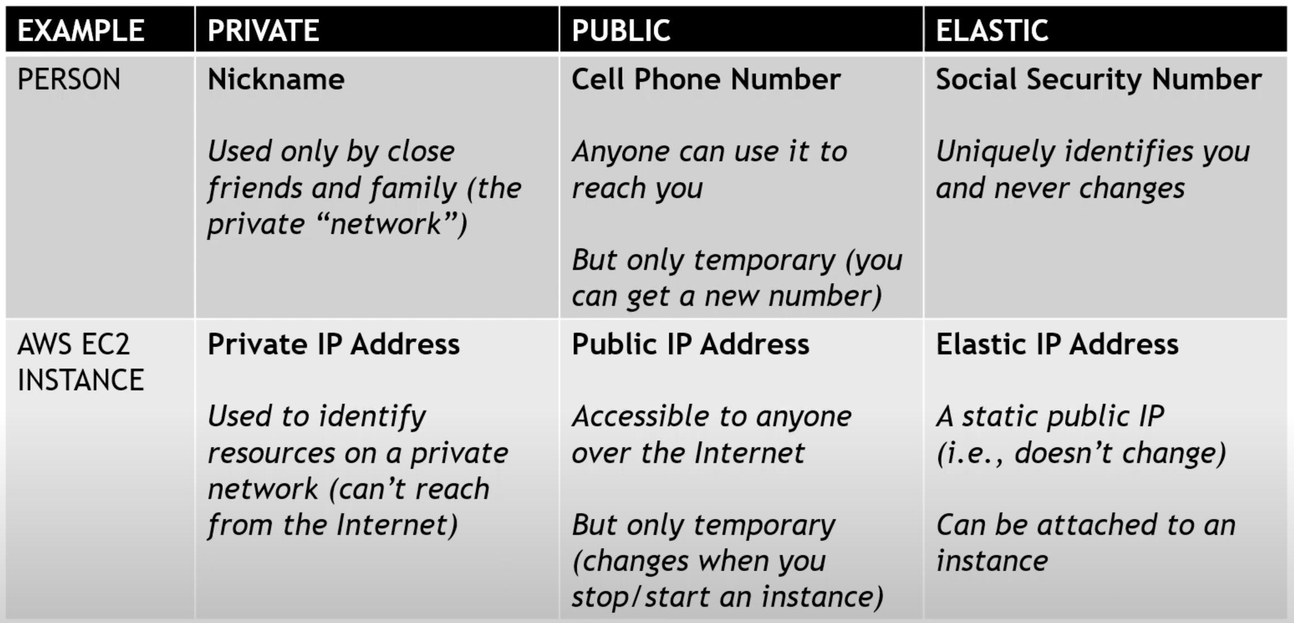
Ip address

Slide 30
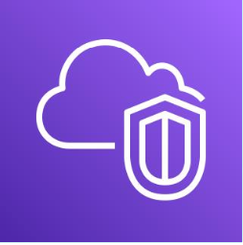
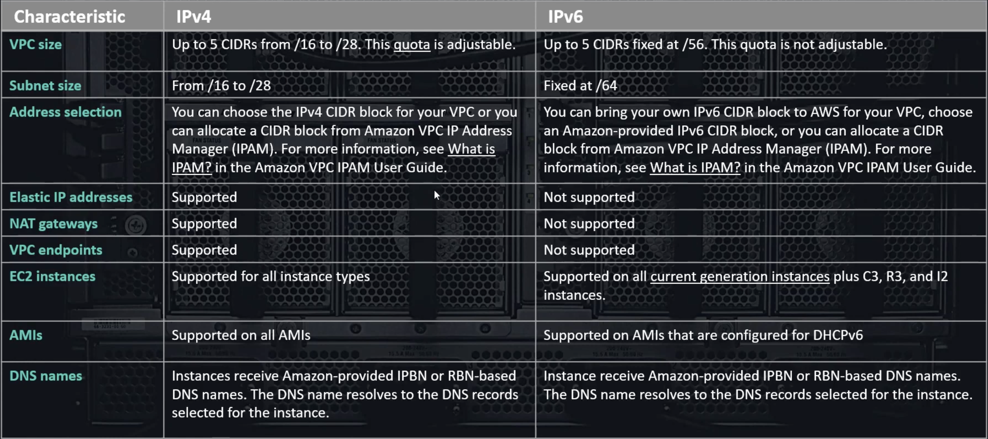
IPv4 vs IPv6

Slide 31
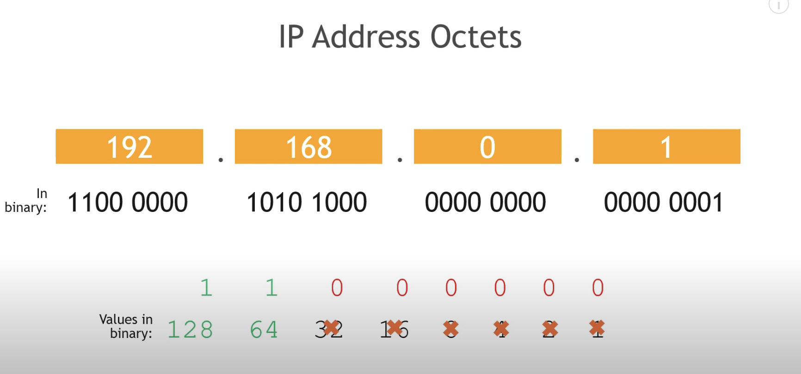
CIDR – Classless intern-domain routing

Slide 32
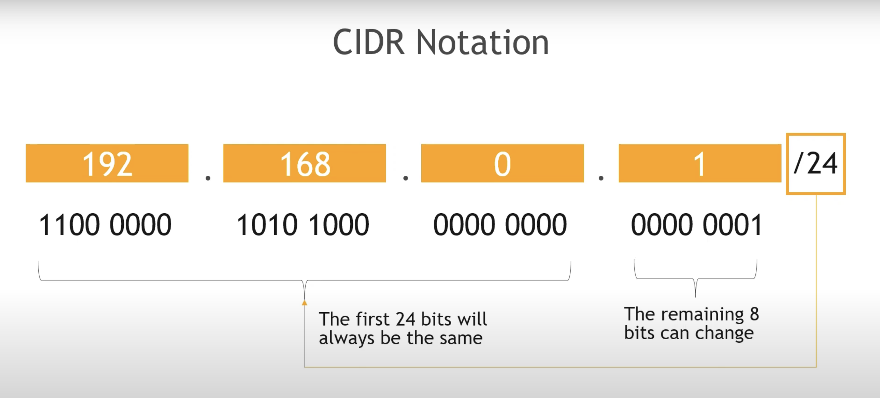
CIDR – Classless intern-domain routing

Slide 33
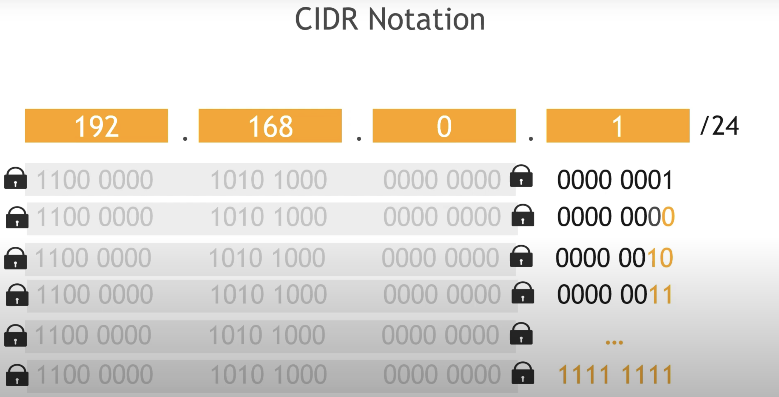
CIDR – Classless intern-domain routing

Slide 34
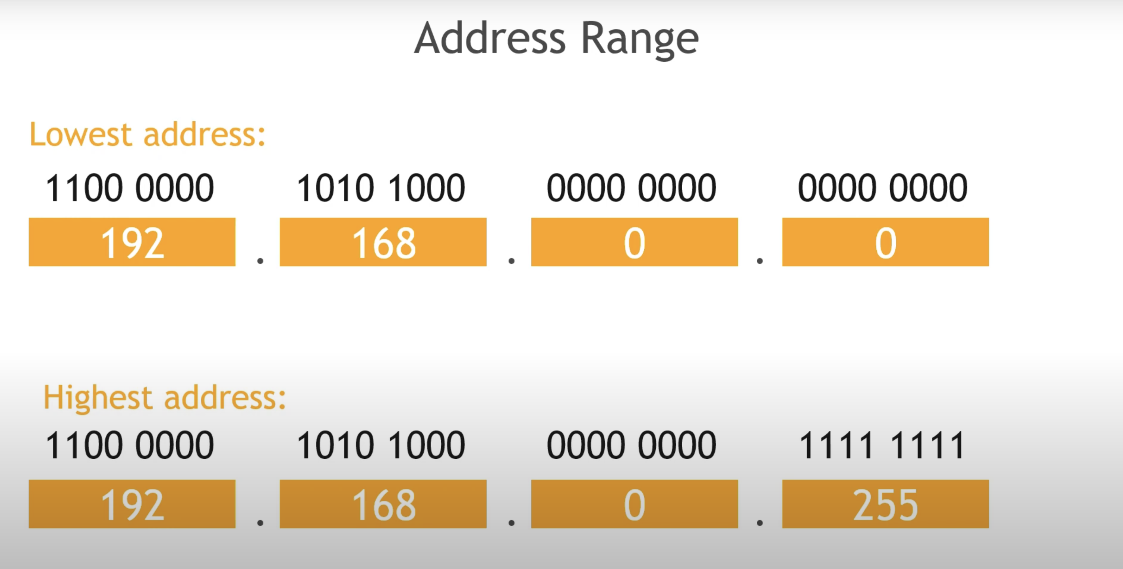
Address Ranger

Slide 35
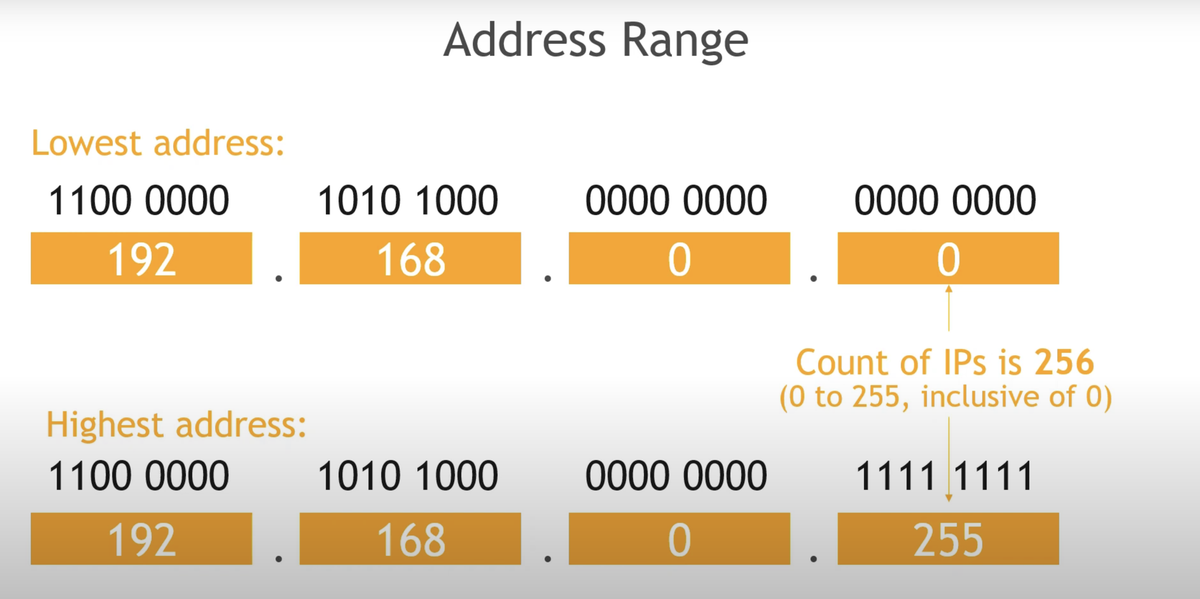
Address Range

Slide 36
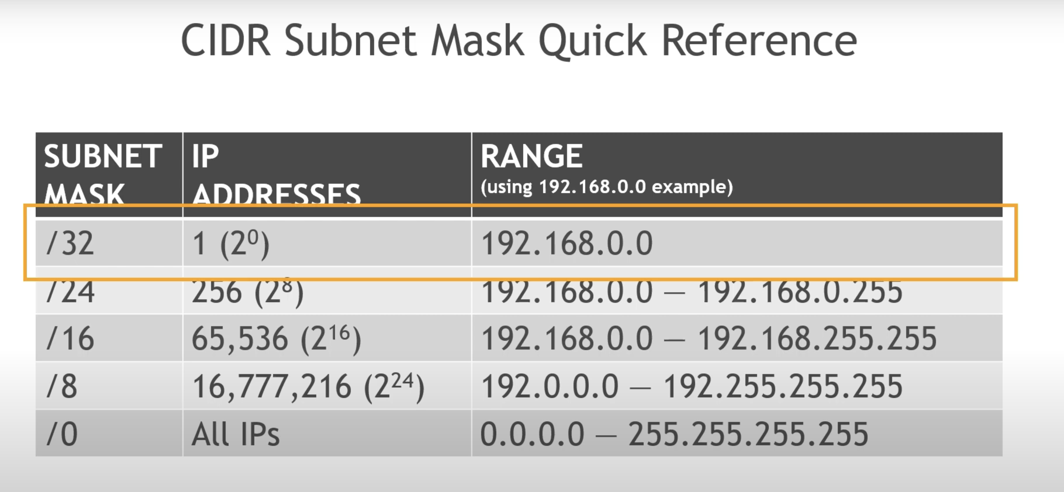
Address Range

Slide 37
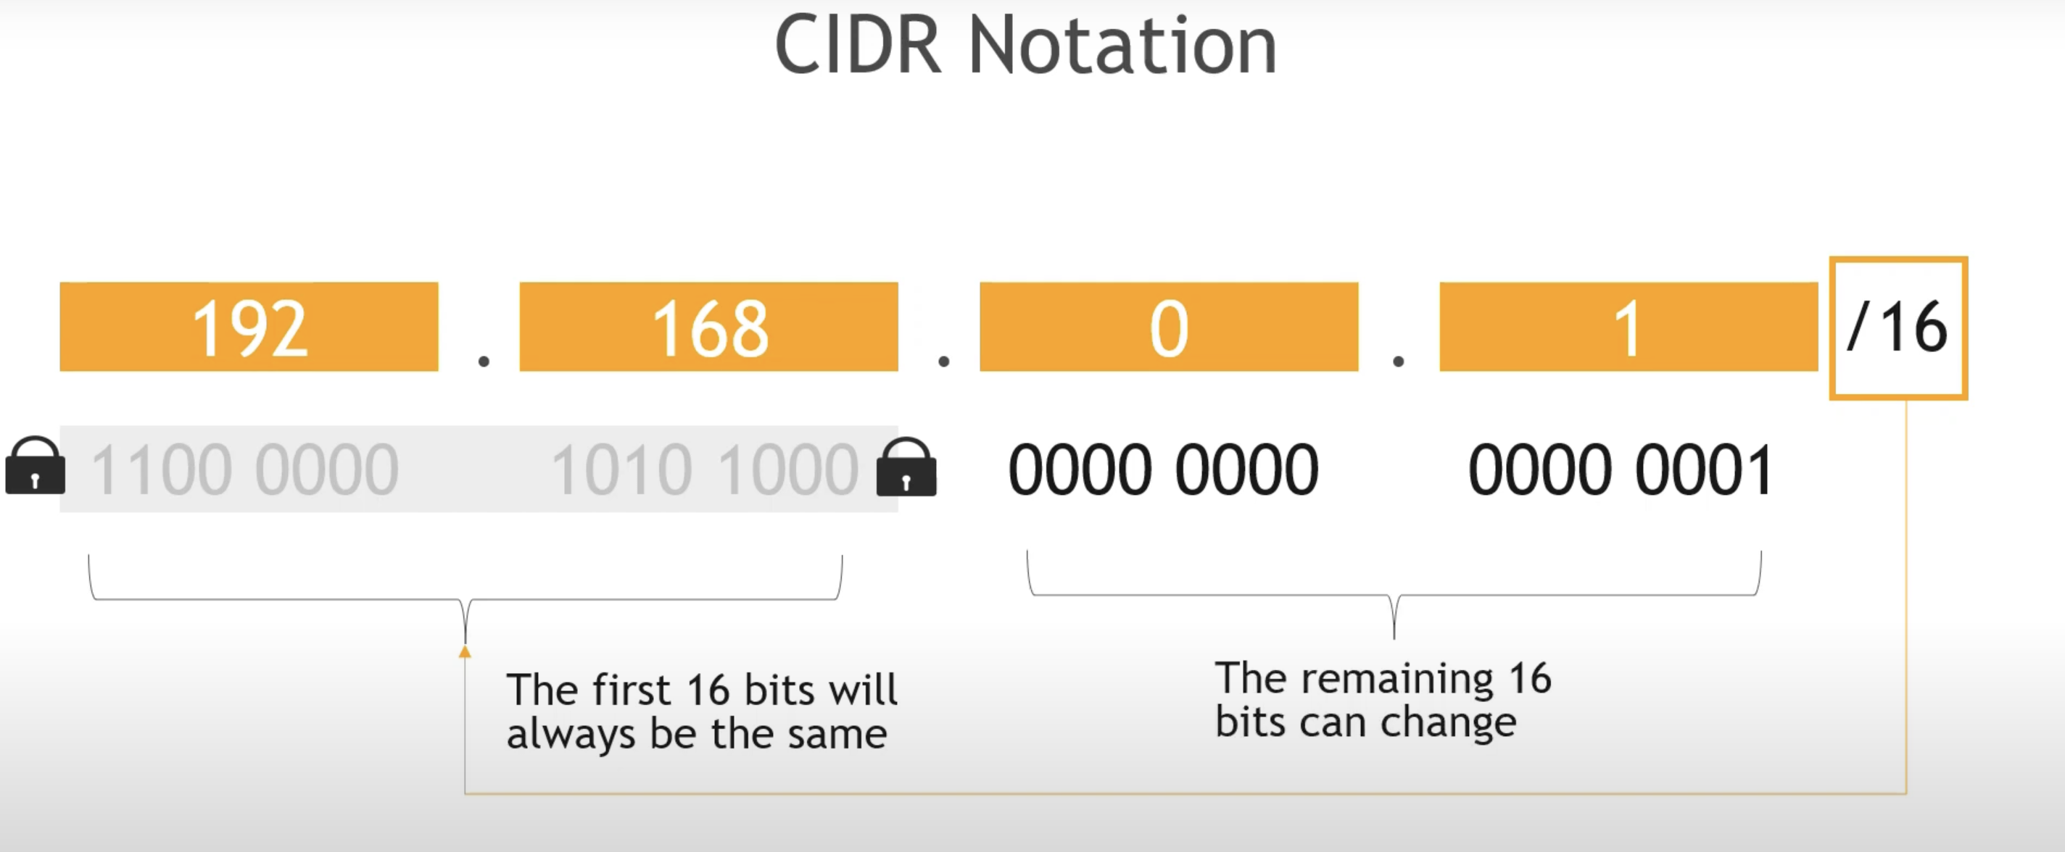
Address Range

Slide 38
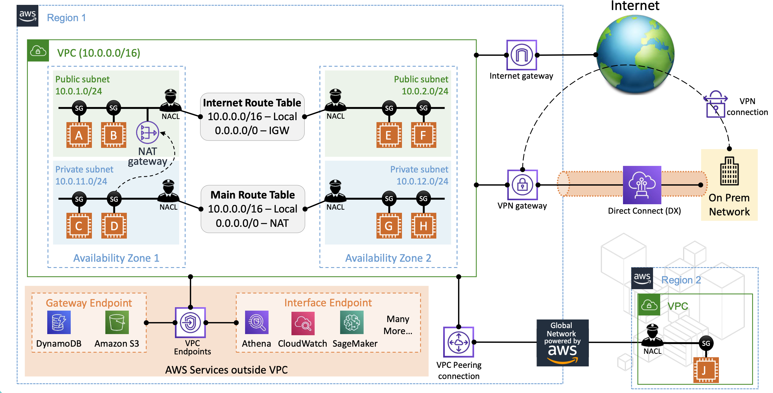
Amazon VPC

Slide 39
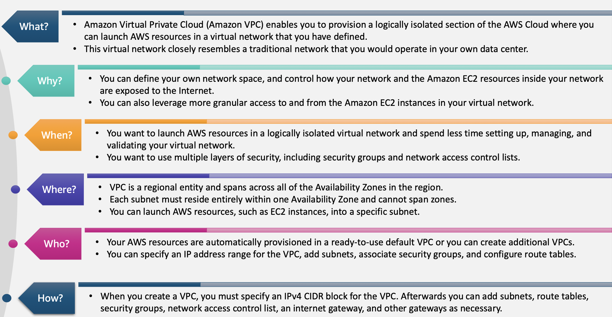
Transit Gateway

Slide 40
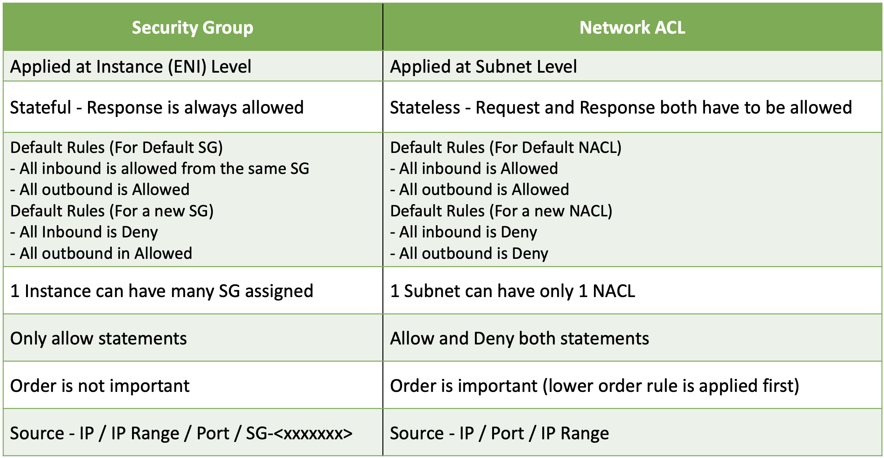
Security Group vs. Network ACL

Slide 41
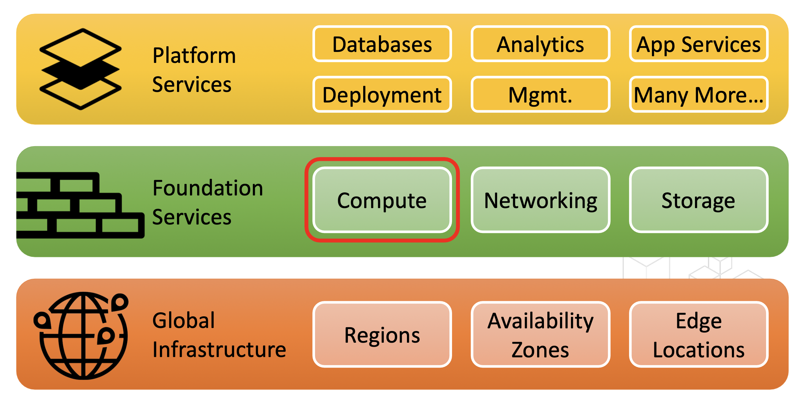

Amazon EC2

Slide 42
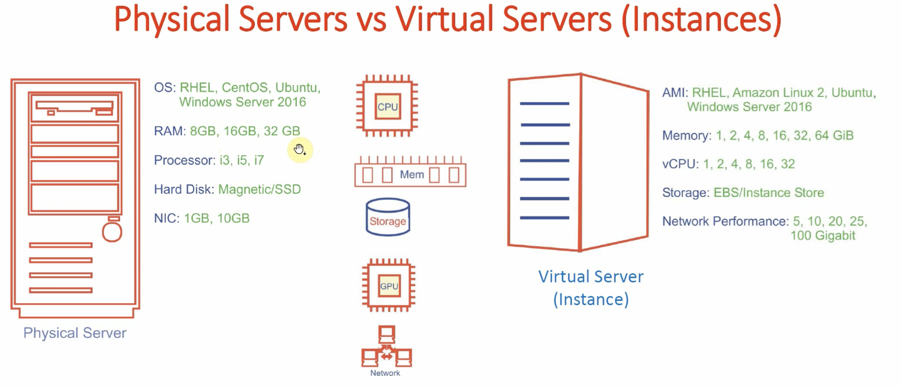
Virtulization

Slide 43
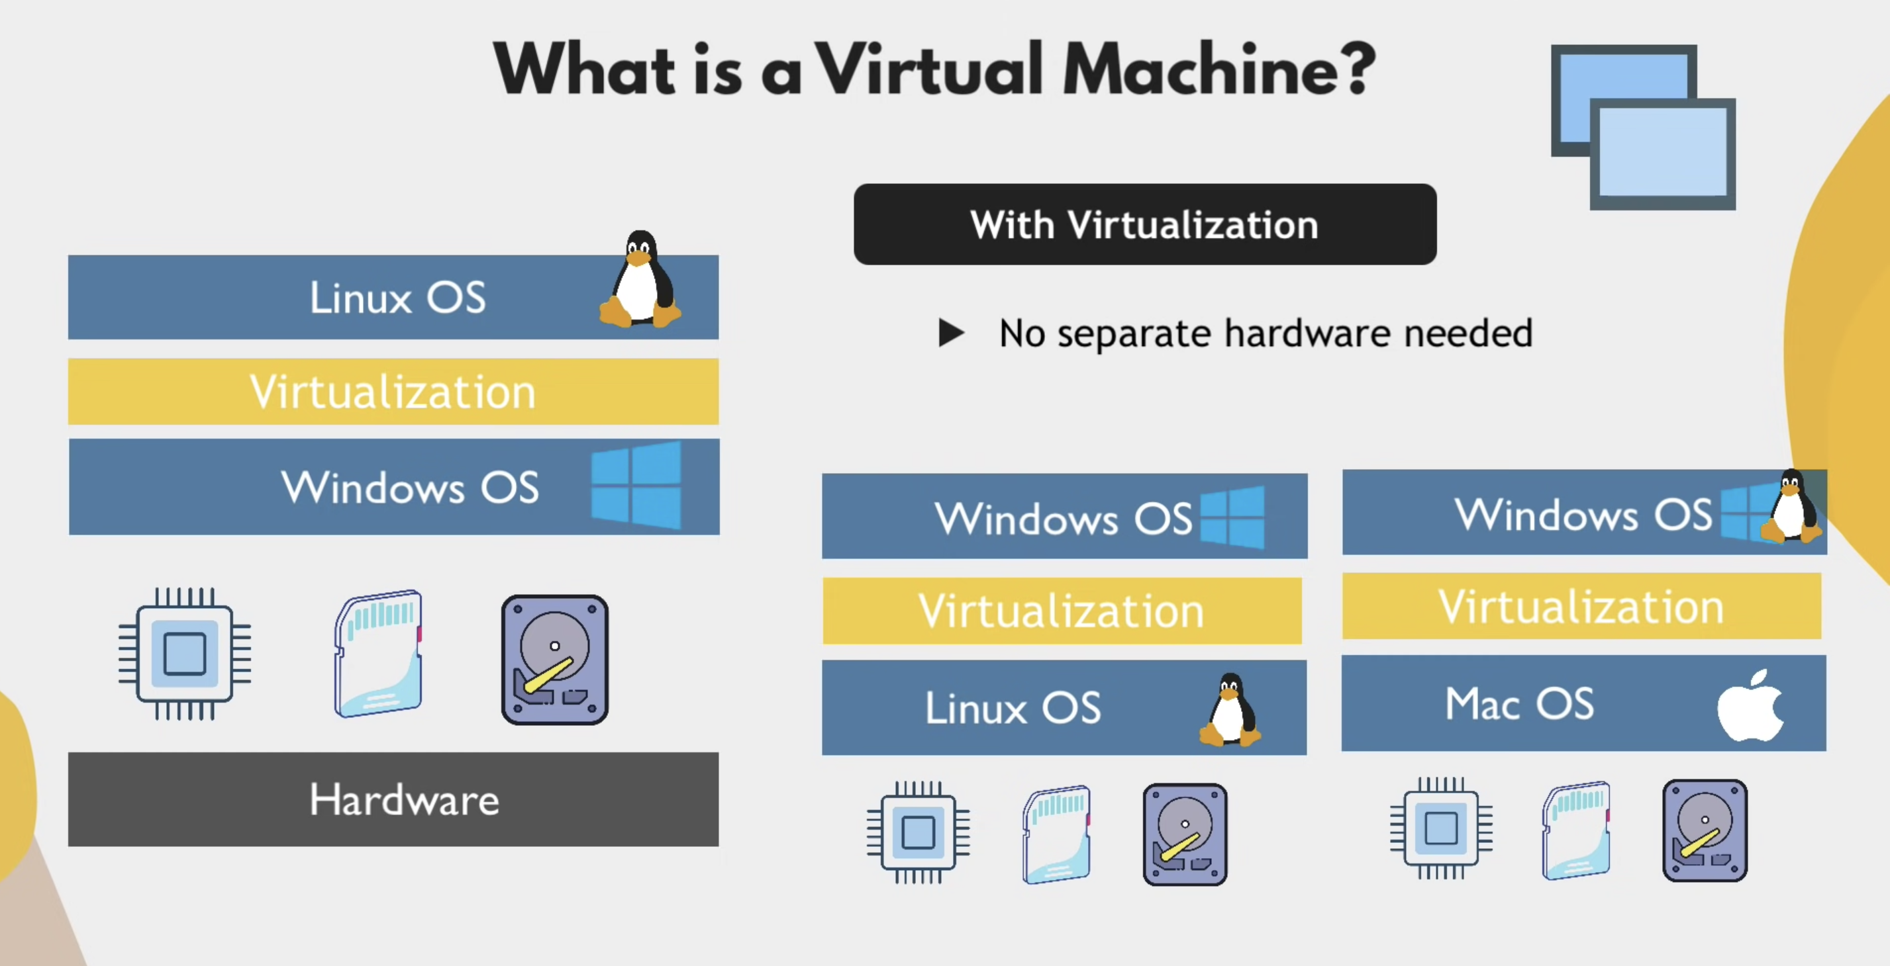
Virtulization

Slide 44
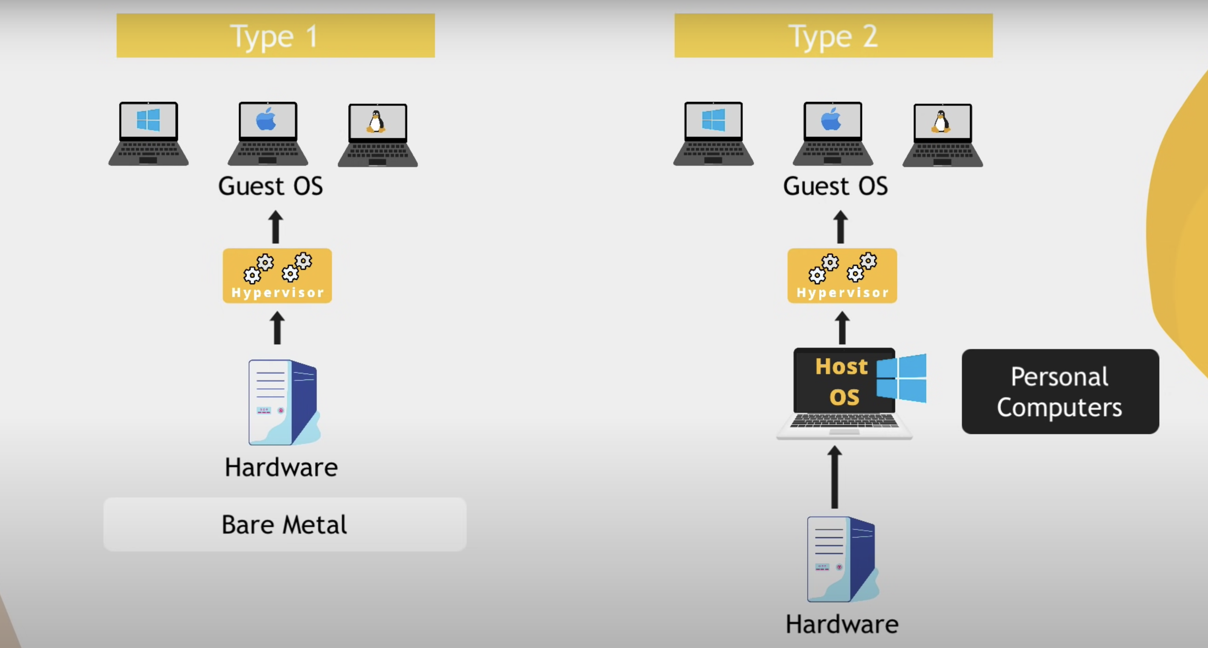
Virtulization

Slide 45
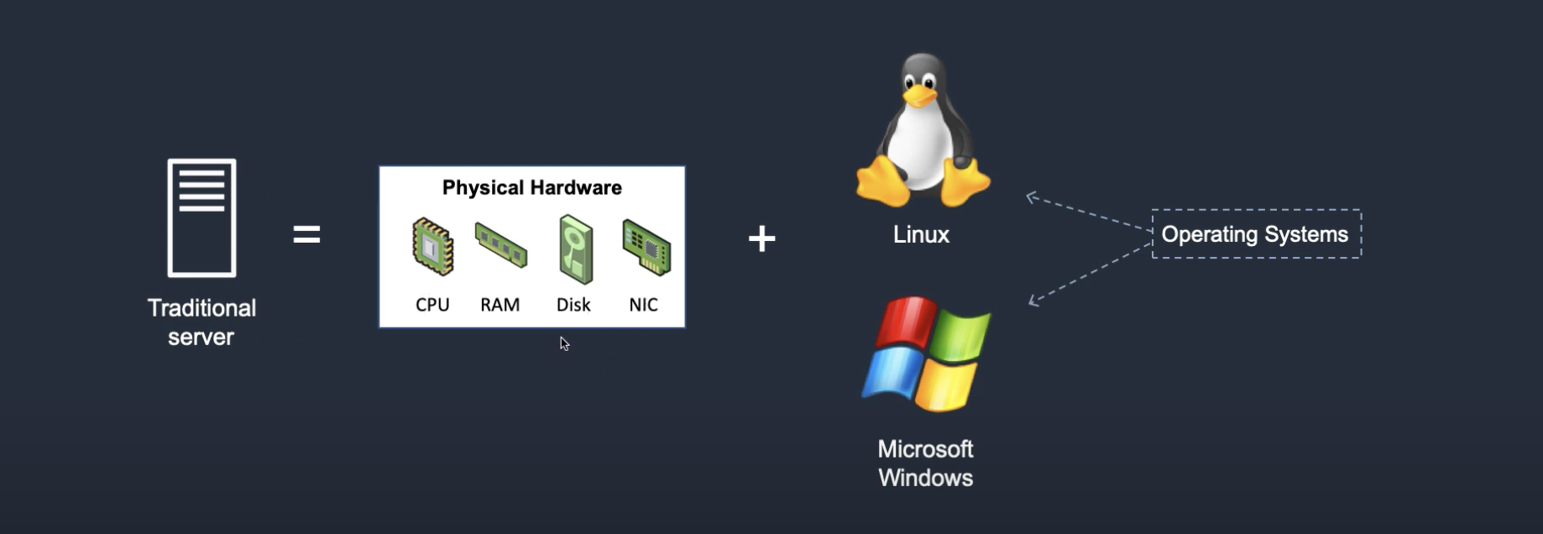


Amazon EC2

Slide 46

What is compute?

Slide 47

Physical Server vs. Virtual Machine

Slide 48

Physical Amazon Elastic Compute Cloud (EC2) – Virtual Server in Cloud

Slide 49

EC2
Amazon EC2 (Elastic Compute Cloud) is a web service interface that provides resizable compute capacity in the AWS cloud. It is designed for developers to have complete control over web-scaling and computing resources.
EC2 instances can be resized, and the number of instances scaled up or down as per our requirement. These instances can be launched in one or more geographical locations or regions, and Availability Zones (AZs).
Each region comprises of several AZs at distinct locations, connected by low latency networks in the same region.

Slide 50

Provisioning an EC2 Instance

Slide 51

EC2 Instance Types

Slide 52

Provisioning an EC2 Instance

